Slide 1



Reinforcement Learning and Autonomous Systems (AI 4102)
Lecture 4 (23/08/2023)
Lecture 5 (28/08/2023)
Instructor: Gourav Saha

Slide 2
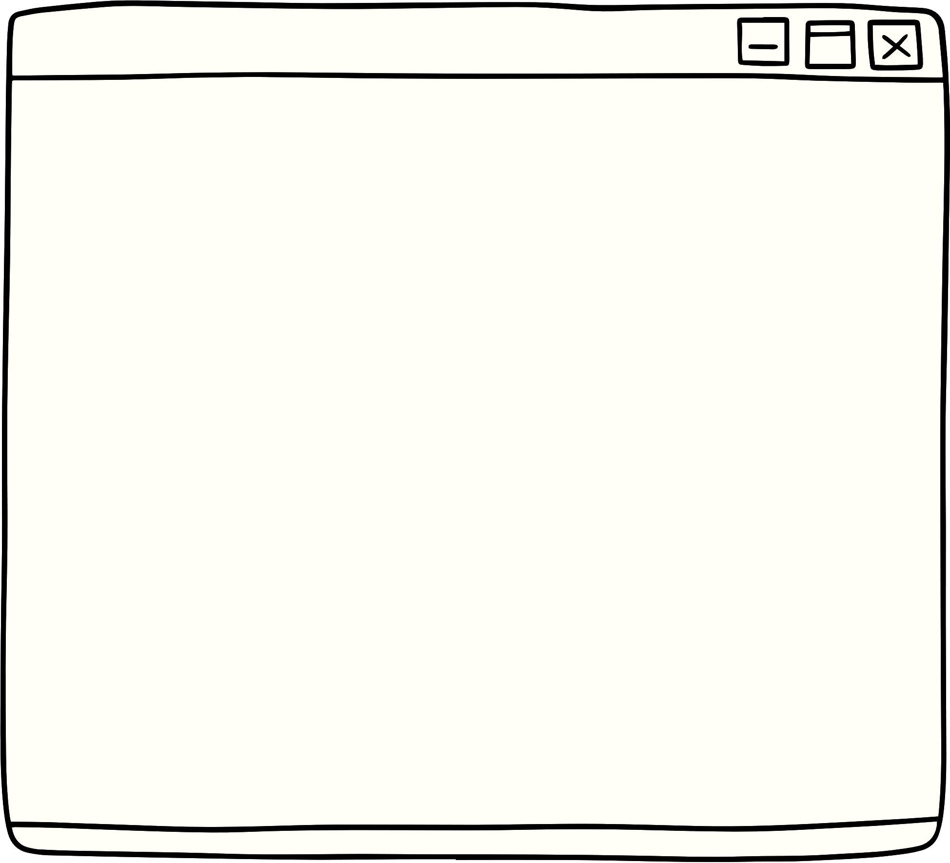
Lecture Content
The Multi-Armed Bandit* (MAB) setup.
A Fundamental Tradeoff.
Mathematical Notations and Concepts.
Policies for Multi-Armed Bandit
*PLEASE NOTE: Multi-Armed Bandit by default means the “simple Multi-Armed Bandit” and NOT “contextual Multi-Armed Bandit”.

Slide 3
Lecture Content
The Multi-Armed Bandit* (MAB) setup.
Applications of Multi-Armed Bandits.
A Fundamental Tradeoff.
Mathematical Notations and Concepts.
Policies for Multi-Armed Bandit
*PLEASE NOTE: Multi-Armed Bandit by default means the “simple Multi-Armed Bandit” and NOT “contextual Multi-Armed Bandit”.

Slide 4



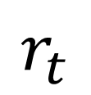
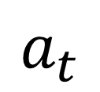
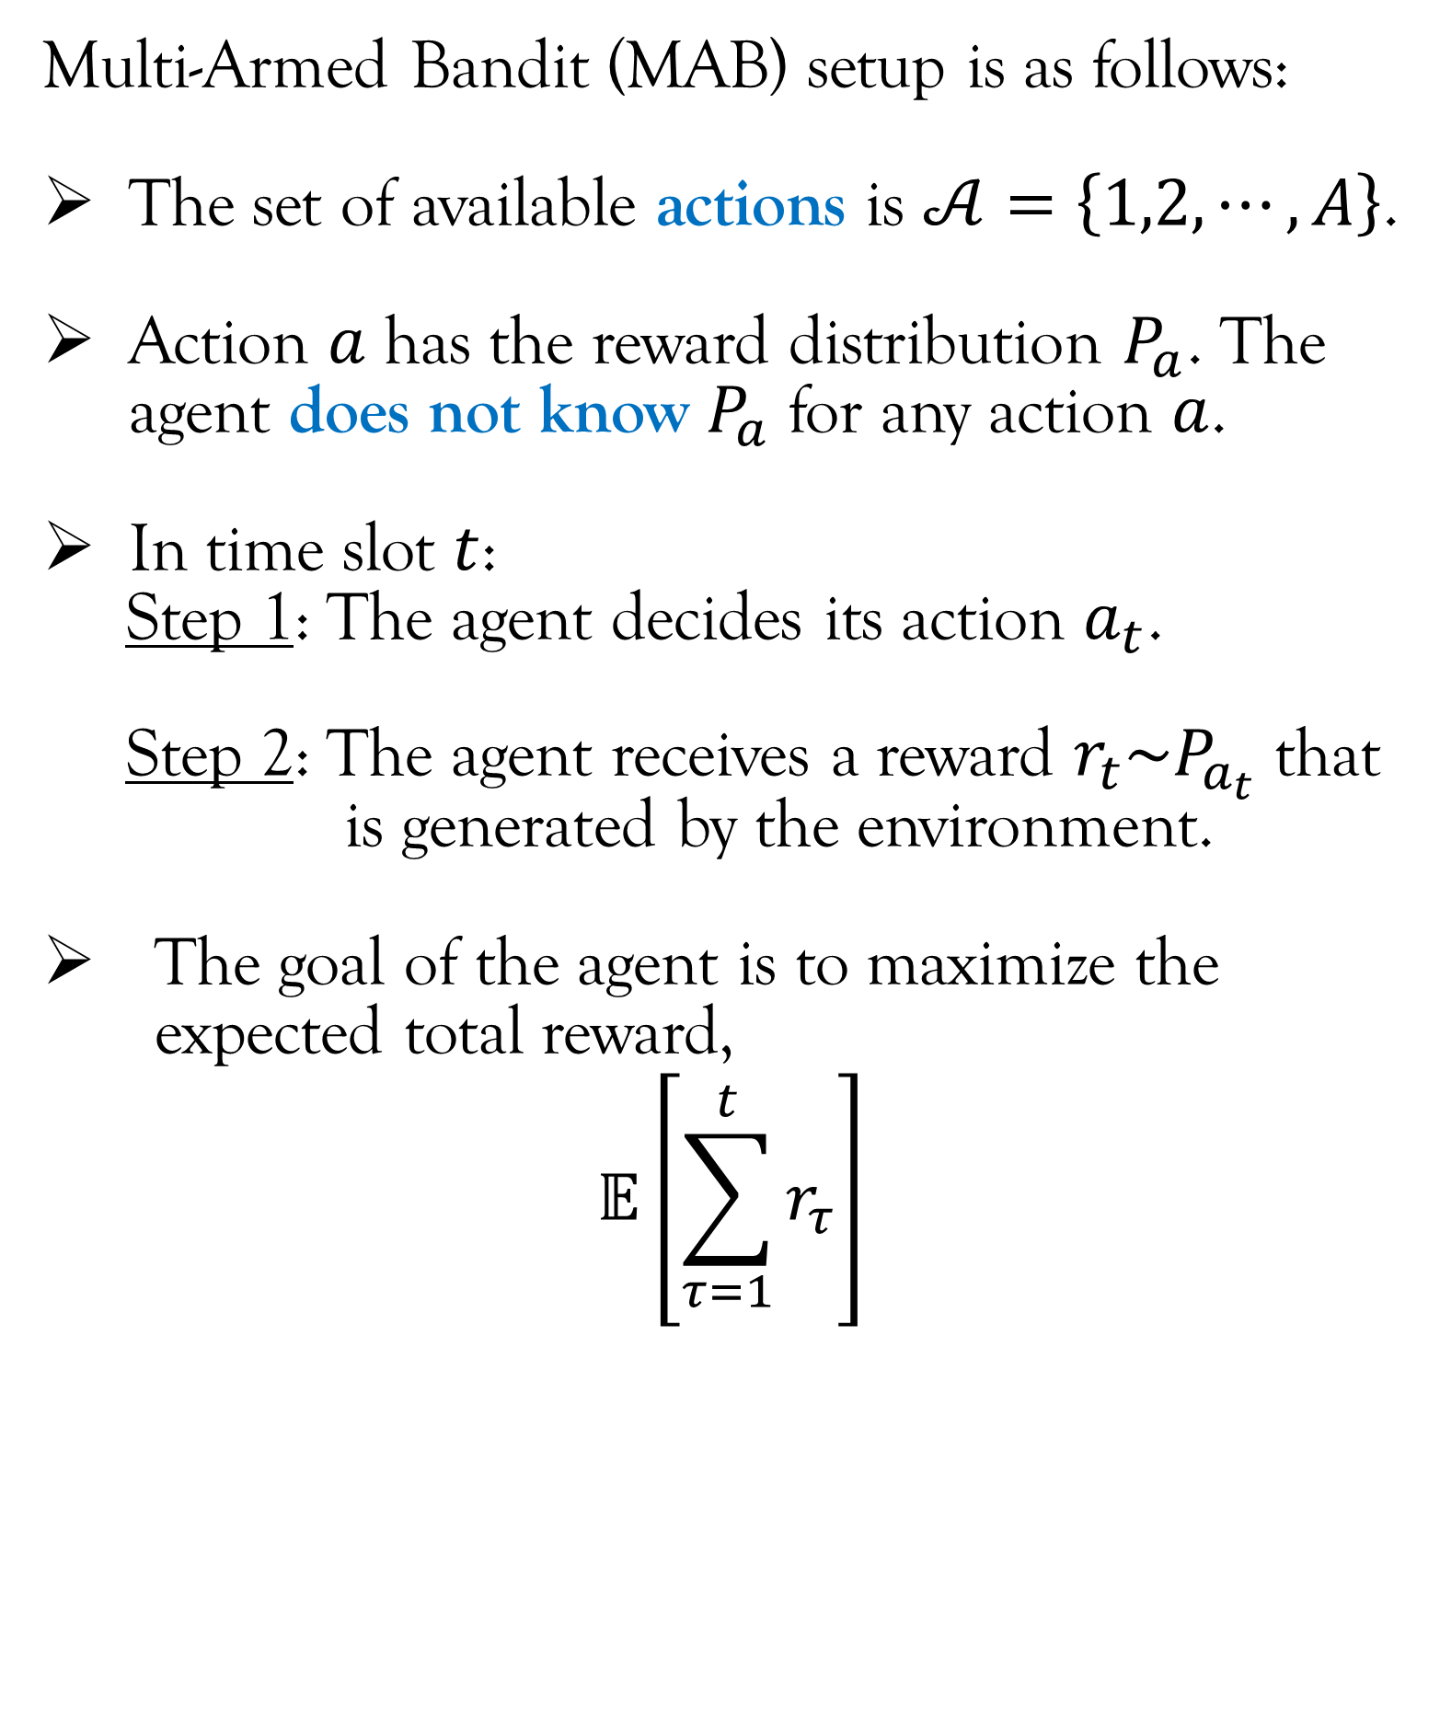
Multi-Armed Bandit Setup
Multi-Armed Bandit (MAB) setup is as follows:
The set of available actions is $𝒜=\left\{1,2,⋯,A\right\}$.
Action $a$ has the reward distribution $P_{a}$. The agent does not know $P_{a}$ for any action $a$.
In time slot $t$:
Step 1: The agent decides its action $a_{t}$.
Step 2: The agent receives a reward $r_{t}\sim P_{a_{t}}$ that
is generated by the environment.
The goal of the agent is to maximize the expected total reward,
$$𝔼\left[\sum_{τ=1}^{t}{r_{τ}}\right]$$
$$a_{t}$$
Agent
Environment
$$r_{t}$$

Slide 5
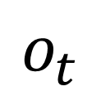
Multi-Armed Bandit Setup
Multi-Armed Bandit (MAB) setup is as follows:
The set of available actions is $𝒜=\left\{1,2,⋯,A\right\}$.
Action $a$ has the reward distribution $P_{a}$. The agent does not know $P_{a}$ for any action $a$.
In time slot $t$:
Step 1: The agent decides its action $a_{t}$.
Step 2: The agent receives a reward $r_{t}\sim P_{a_{t}}$ that
is generated by the environment.
The goal of the agent is to maximize the expected total reward,
$$𝔼\left[\sum_{τ=1}^{t}{r_{τ}}\right]$$
$$a_{t}$$
Agent
Environment
$$r_{t}$$
$$o_{t}$$
There is no observation in MAB setup.

Slide 6
Multi-Armed Bandit Setup
Multi-Armed Bandit (MAB) setup is as follows:
The set of available actions is $𝒜=\left\{1,2,⋯,A\right\}$.
Action $a$ has the reward distribution $P_{a}$. The agent does not know $P_{a}$ for any action $a$.
In time slot $t$:
Step 1: The agent decides its action $a_{t}$.
Step 2: The agent receives a reward $r_{t}\sim P_{a_{t}}$ that
is generated by the environment.
The goal of the agent is to maximize the expected total reward,
$$𝔼\left[\sum_{τ=1}^{t}{r_{τ}}\right]$$
$$a_{t}$$
Agent
Environment
$$r_{t}$$
IMPORTANT: The agent does not get to see the reward of those actions that it did not take.

Slide 7
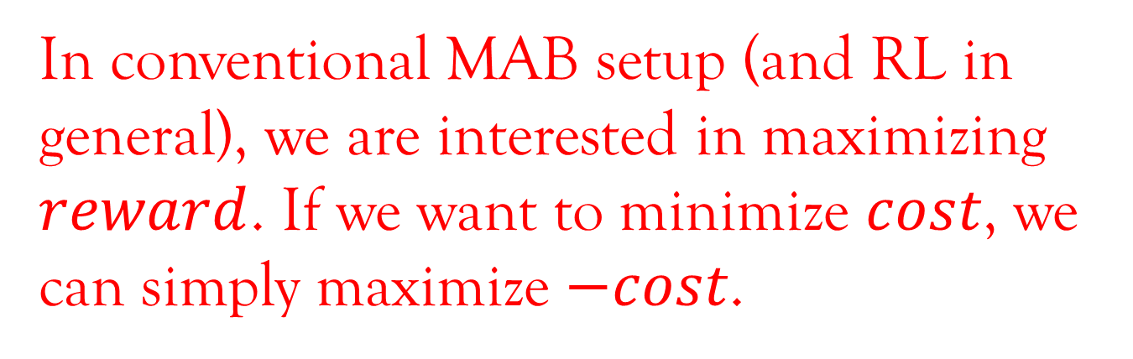
Multi-Armed Bandit Setup
Multi-Armed Bandit (MAB) setup is as follows:
The set of available actions is $𝒜=\left\{1,2,⋯,A\right\}$.
Action $a$ has the reward distribution $P_{a}$. The agent does not know $P_{a}$ for any action $a$.
In time slot $t$:
Step 1: The agent decides its action $a_{t}$.
Step 2: The agent receives a reward $r_{t}\sim P_{a_{t}}$ that
is generated by the environment.
The goal of the agent is to maximize the expected total reward,
$$𝔼\left[\sum_{τ=1}^{t}{r_{τ}}\right]$$
$$a_{t}$$
Agent
Environment
$$r_{t}$$
In conventional MAB setup (and RL in general), we are interested in maximizing $reward$. If we want to minimize $cost$, we can simply maximize $−cost$.

Slide 8
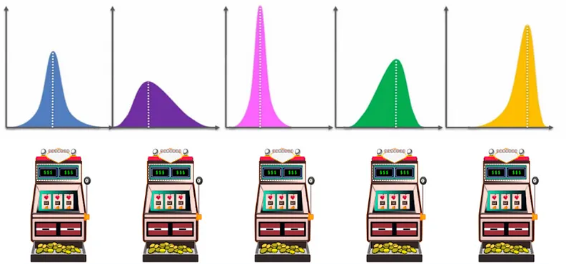

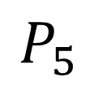
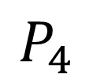
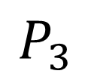
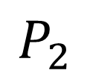
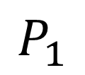
Multi-Armed Bandit Setup
$$P_{1}$$
$$P_{2}$$
$$P_{3}$$
$$P_{4}$$
$$P_{5}$$
The origin of the name “Multi-Armed Bandit”:
The name originates from a bandit playing lottery machines in a casino.
Each lottery machine is called an arm referring to the lever of the lottery machine. So basically “arms” and “actions” are analogous. We will use these two terms interchangeably throughout Module 1.
Each lottery machine has its own probability distribution of dispensing cash reward. The bandit does not know these distributions.
The aim of the bandit is to maximize the total cash reward over multiple plays.
Arm 1
Arm 2
Arm 3
Arm 4
Arm 5
Bandit

Slide 9

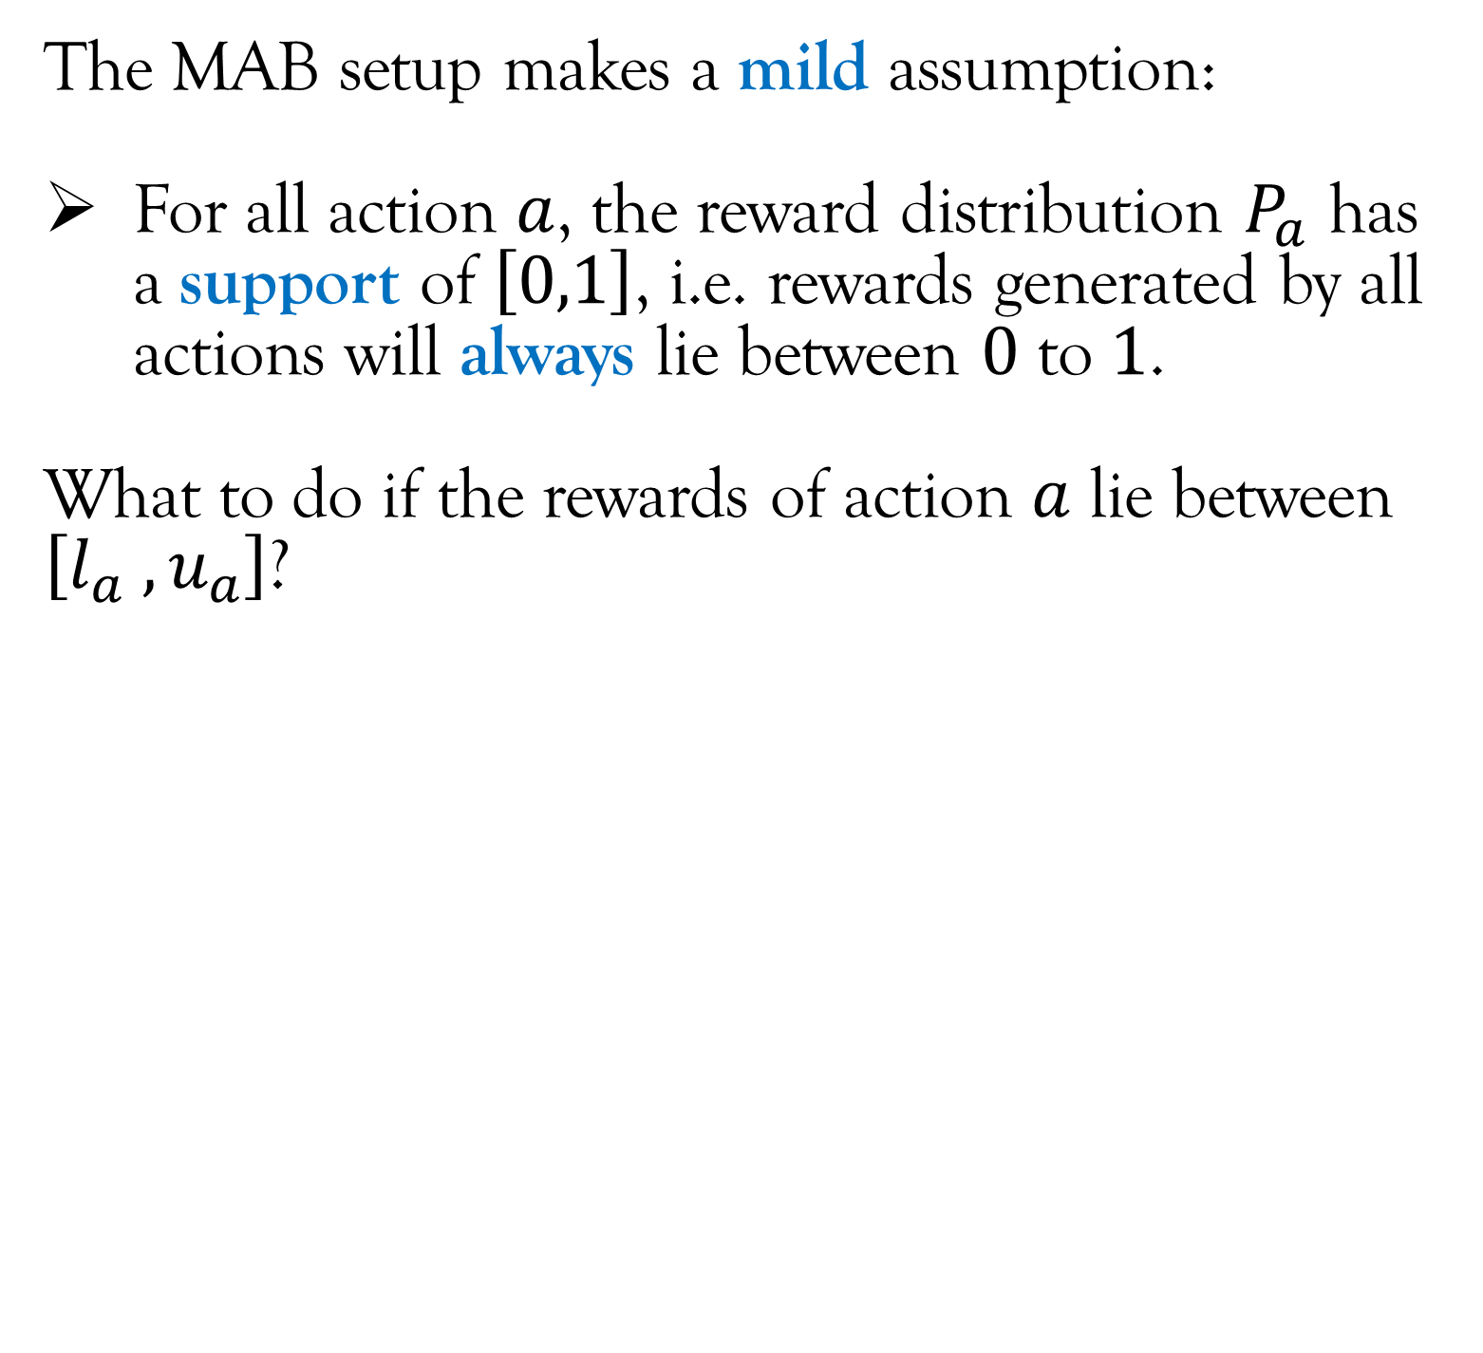
Multi-Armed Bandit Setup
The MAB setup makes a mild assumption:
For all action $a$, the reward distribution $P_{a}$ has a support of $\left[0,1\right]$, i.e. rewards generated by all actions will always lie between $0$ to $1$.
What to do if the rewards of action $a$ lie between $\left[l_{a} , u_{a}\right]$?
$$a_{t}$$
Agent
Environment
$$r_{t}$$

Slide 10
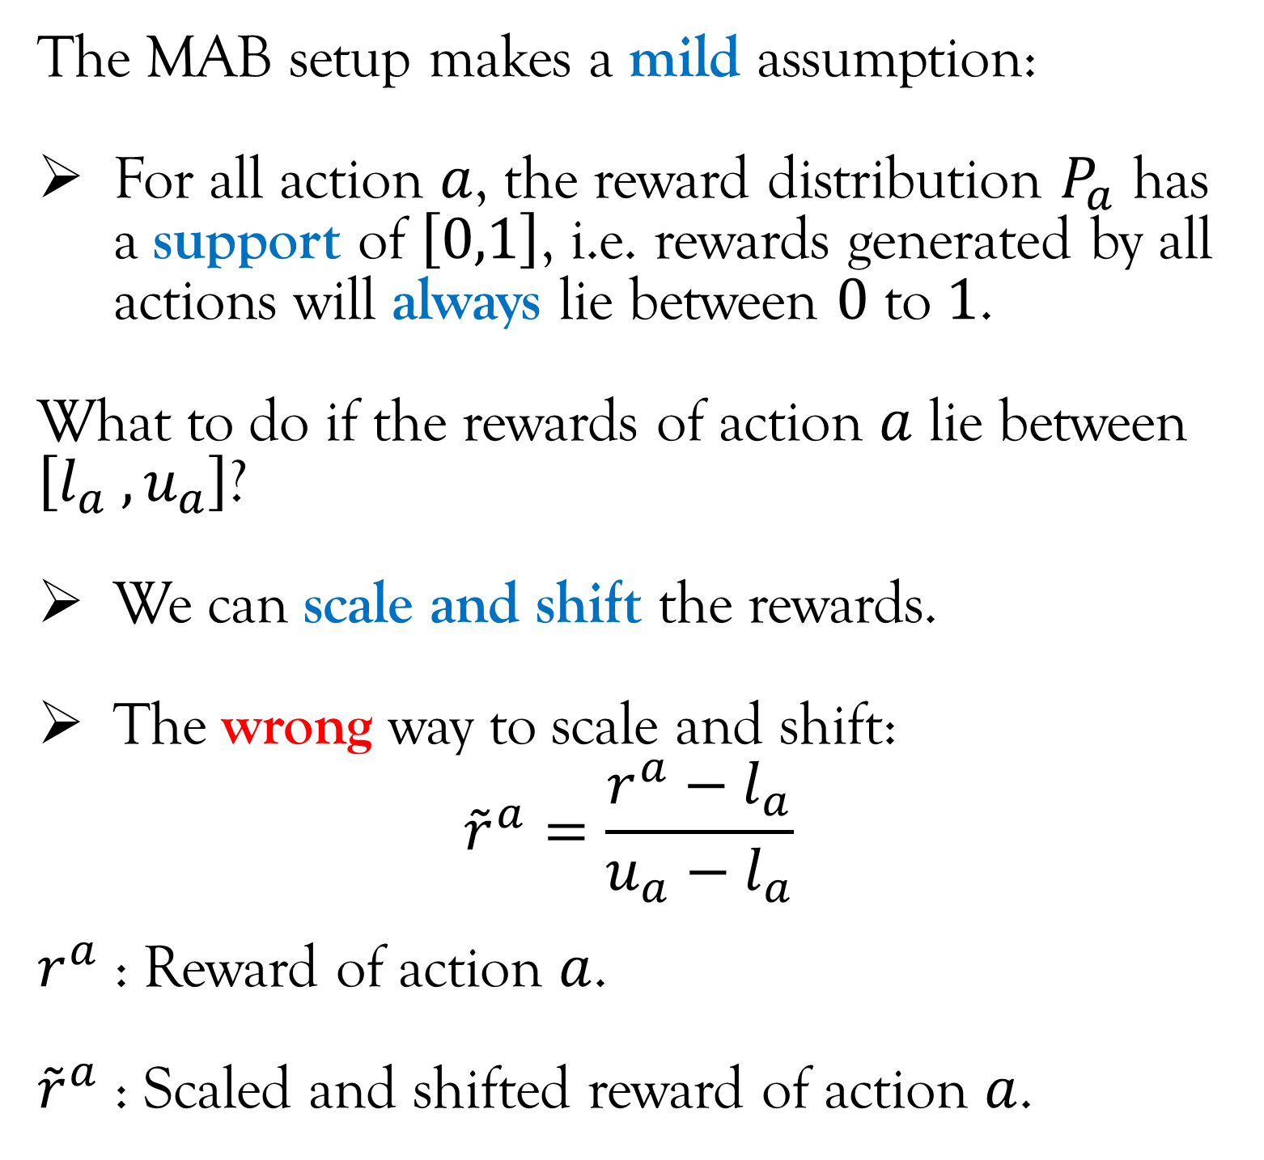
Multi-Armed Bandit Setup
The MAB setup makes a mild assumption:
For all action $a$, the reward distribution $P_{a}$ has a support of $\left[0,1\right]$, i.e. rewards generated by all actions will always lie between $0$ to $1$.
What to do if the rewards of action $a$ lie between $\left[l_{a} , u_{a}\right]$?
We can scale and shift the rewards.
The wrong way to scale and shift:
$${\tilde{r}}^{a}=\frac{r^{a}−l_{a}}{u_{a}−l_{a}}$$
$r^{a}$ : Reward of action $a$.
${\tilde{r}}^{a}$ : Scaled and shifted reward of action $a$.
$$a_{t}$$
Agent
Environment
$$r_{t}$$
This approach uses different scaling and shifting factors for different actions. Scaling and shifting the rewards by different factor will lead to erroneous result when we want to compare rewards of two different actions.
Shifting factor
Scaling factor

Slide 11
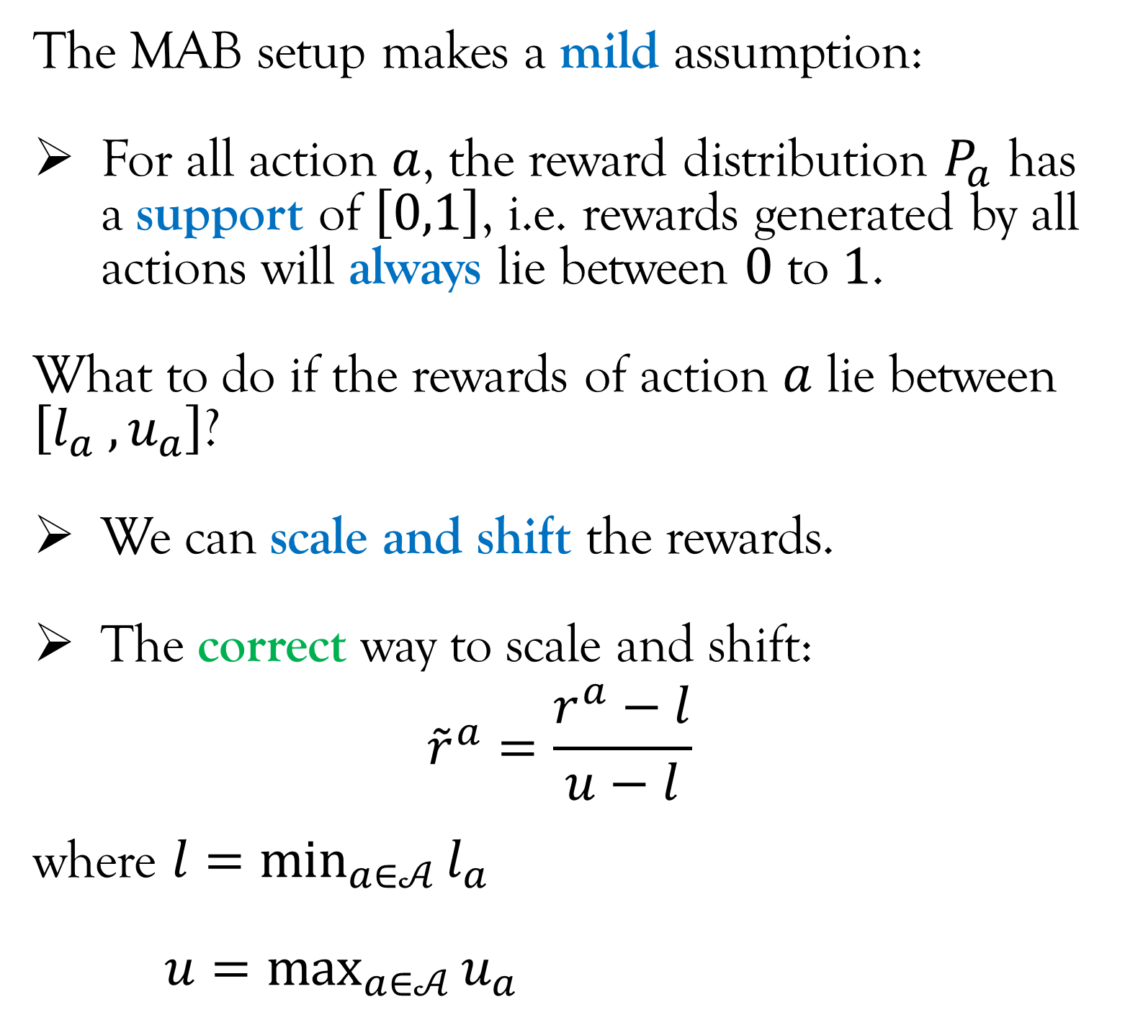
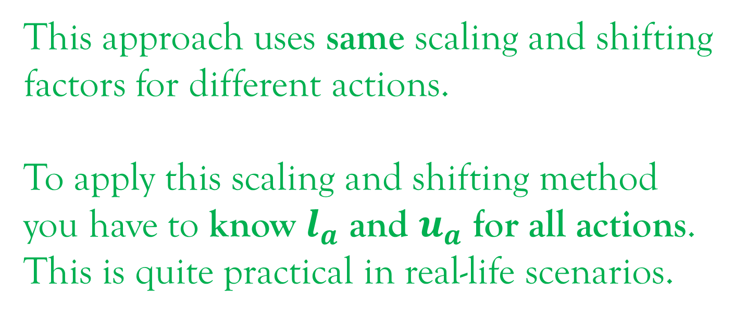
Multi-Armed Bandit Setup
The MAB setup makes a mild assumption:
For all action $a$, the reward distribution $P_{a}$ has a support of $\left[0,1\right]$, i.e. rewards generated by all actions will always lie between $0$ to $1$.
What to do if the rewards of action $a$ lie between $\left[l_{a} , u_{a}\right]$?
We can scale and shift the rewards.
The correct way to scale and shift:
$${\tilde{r}}^{a}=\frac{r^{a}−l}{u−l}$$
where $l=\min_{a∈𝒜}{l_{a}}$
$u=\max_{a∈𝒜}{u_{a}}$
$$a_{t}$$
Agent
Environment
$$r_{t}$$
This approach uses same scaling and shifting factors for different actions.
To apply this scaling and shifting method you have to know $l_{a}$ and $u_{a}$ for all actions. This is quite practical in real-life scenarios.
Shifting factor
Scaling factor

Slide 12
Multi-Armed Bandit Setup
Applications of Multi-Armed Bandit:
Online advertising: Which advertisement to show to get more click through rate?
Clinical trials: Which drug or what dose of drug to administer to cure a patient?
Network routing: In wireless/road network, which path to take in order to minimize the time to go from source to destination?
Millimeter Wave Communication: Which direction to point the millimeter wave antenna to maximize throughput?
Recommendation systems (Netflix): Which movies to recommend to maximize user satisfaction?
Feature Selection in ML: Which set of features to select in order to get the best performance of the ML model?

Slide 13
Multi-Armed Bandit Setup
Applications of Multi-Armed Bandit:
Online advertising: Which advertisement to show to get more click through rate?
Clinical trials: Which drug or what dose of drug to administer to cure a patient?
Network routing: In wireless/road network, which path to take in order to minimize the time to go from source to destination?
Millimeter Wave Communication: Which direction to point the millimeter wave antenna to maximize throughput?
Recommendation systems (Netflix): Which movies to recommend to maximize user satisfaction?
Feature Selection in ML: Which set of features to select in order to get the best performance of the ML model?
Strictly, the real-life implementation of these falls under “contextual bandits”!

Slide 14
Multi-Armed Bandit Setup
Applications of Multi-Armed Bandit:
Online advertising: Which advertisement to show to get more click through rate?
Clinical trials: Which drug or what dose of drug to administer to cure a patient?
Network routing: In wireless/road network, which path to take in order to minimize the time to go from source to destination?
Millimeter Wave Communication: Which direction to point the millimeter wave antenna to maximize throughput?
Recommendation systems (Netflix): Which movies to recommend to maximize user satisfaction?
Feature Selection in ML: Which set of features to select in order to get the best performance of the ML model?
Strictly, they fall under “combinatorial bandits” that are much harder!

Slide 15
Lecture Content
The Multi-Armed Bandit* (MAB) setup.
A Fundamental Tradeoff.
Mathematical Notations and Concepts.
Policies for Multi-Armed Bandit
*PLEASE NOTE: Multi-Armed Bandit by default means the “simple Multi-Armed Bandit” and NOT “contextual Multi-Armed Bandit”.

Slide 16


A Fundamental Tradeoff
Let’s get back to the warehouse routing example that we introduced in Lecture 1.
Suppose you don’t have access to any google maps*, how will decide which route to take in order to minimize the average travel time?
*Because google maps information is a context and we are not dealing with contextual bandit yet.
Mahindra
University
NOTE: Routes 1 and 2 merges at one point
Route 1
Route 2
Route 3

Slide 17
A Fundamental Tradeoff
IMPORTANT: The entirety of RL relies a fundamental concept called “exploration-exploitation tradeoff”.
In this warehouse routing example:
Exploration: Take a route that might not have given the minimum (average) travel time in the past just to see if it gives better outcome.
Exploitation: Take the route that has given the minimum (average) travel time in the past.
If we explore too little, then we might get stuck with a sub-optimal action. But, if we explore too much we may keep opting for the sub-optimal action again and again.
Mahindra
University
NOTE: Routes 1 and 2 merges at one point
Route 1
Route 2
Route 3

Slide 18
Lecture Content
The Multi-Armed Bandit* (MAB) setup.
A Fundamental Tradeoff.
Mathematical Notations and Concepts.
Policies for Multi-Armed Bandit.
*PLEASE NOTE: Multi-Armed Bandit by default means the “simple Multi-Armed Bandit” and NOT “contextual Multi-Armed Bandit”.

Slide 19
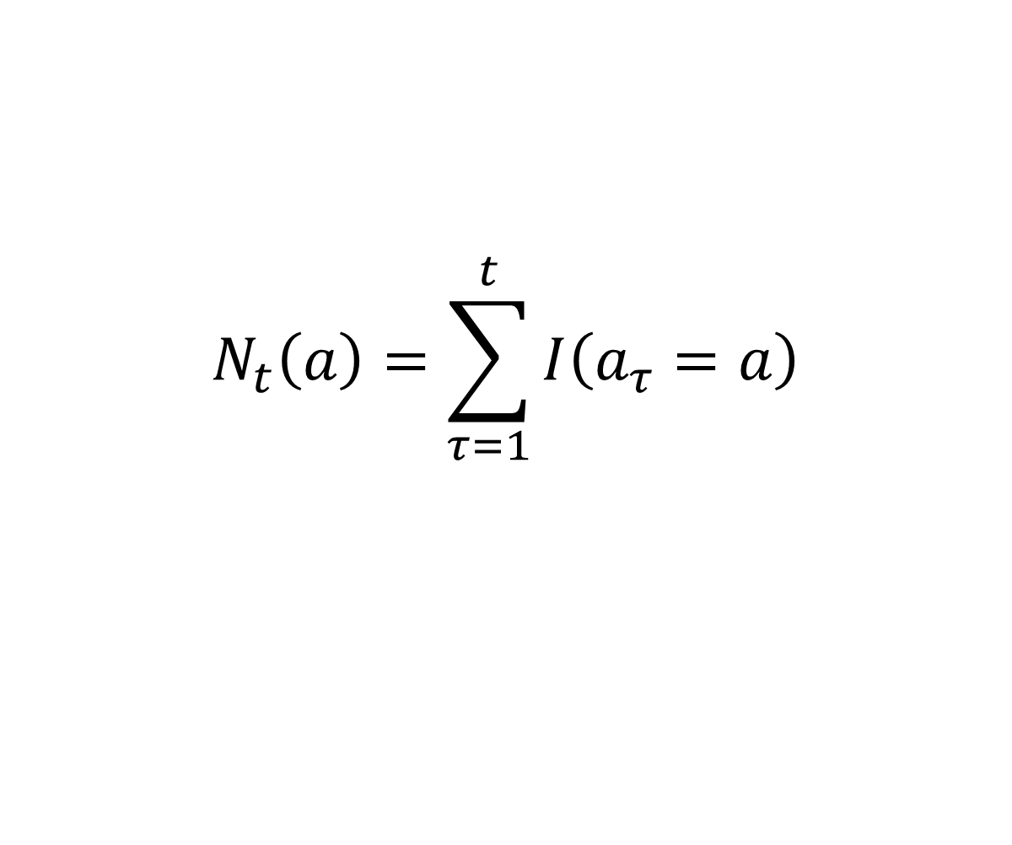
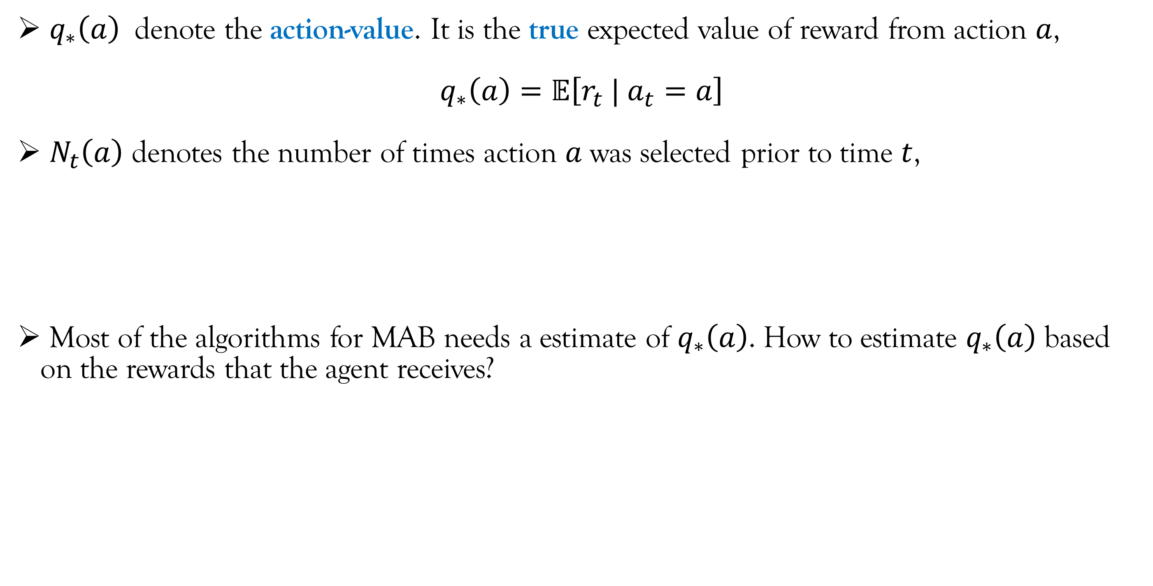
Mathematical Notations and Concepts
$q_{∗}\left(a\right)$ denote the action-value. It is the true expected value of reward from action $a$,
$$q_{∗}\left(a\right)=𝔼\left[r_{t} | a_{t}=a\right]$$
$N_{t}\left(a\right)$ denotes the number of times action $a$ was selected prior to time $t$,
Most of the algorithms for MAB needs a estimate of $q_{∗}\left(a\right)$. How to estimate $q_{∗}\left(a\right)$ based on the rewards that the agent receives?
$$N_{t}\left(a\right)=\sum_{τ=1}^{t}{I\left(a_{τ}=a\right)}$$
Indicator function

Slide 20
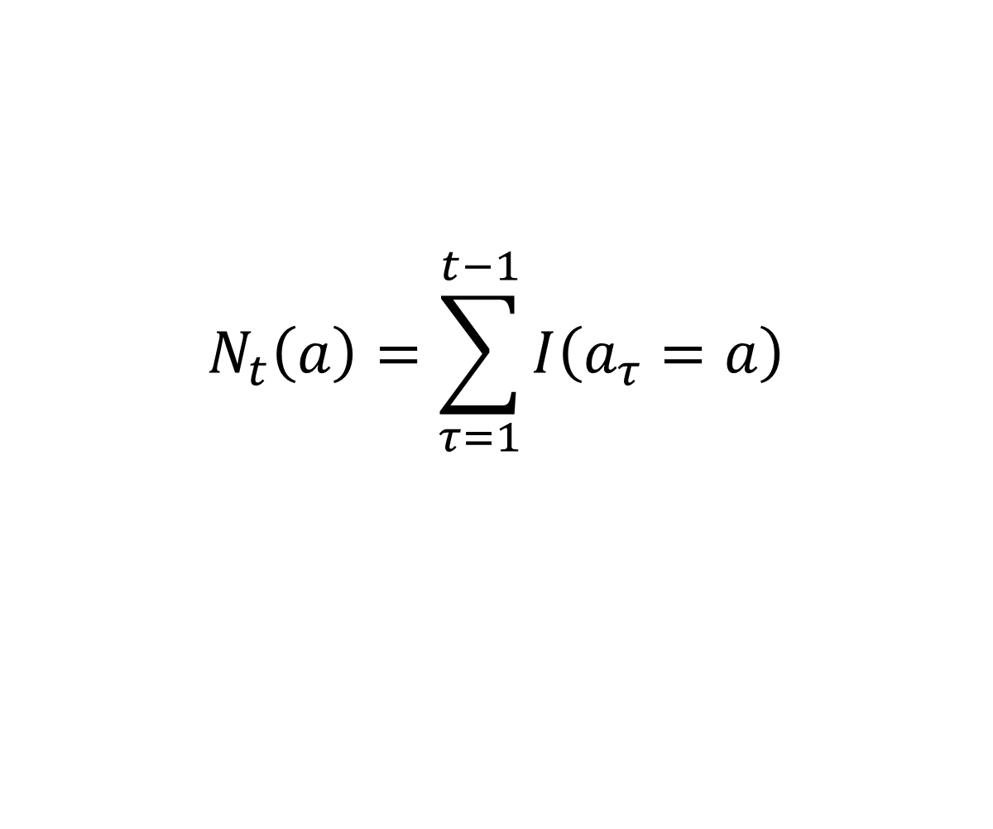
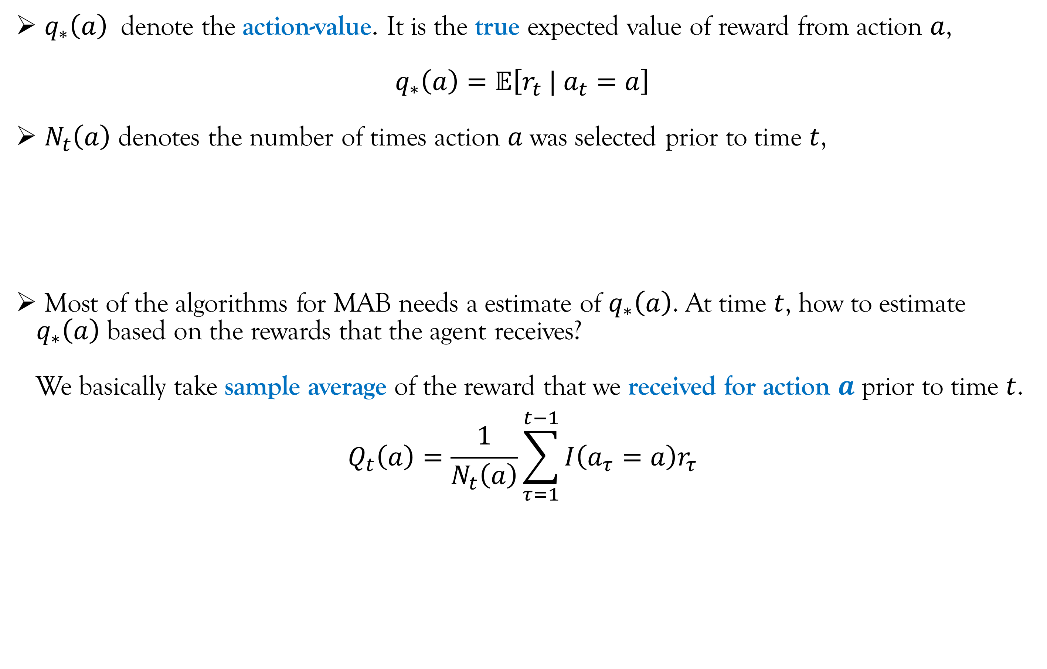
Mathematical Notations and Concepts
$q_{∗}\left(a\right)$ denote the action-value. It is the true expected value of reward from action $a$,
$$q_{∗}\left(a\right)=𝔼\left[r_{t} | a_{t}=a\right]$$
$N_{t}\left(a\right)$ denotes the number of times action $a$ was selected prior to time $t$,
Most of the algorithms for MAB needs a estimate of $q_{∗}\left(a\right)$. At time $t$, how to estimate $q_{∗}\left(a\right)$ based on the rewards that the agent receives?
We basically take sample average of the reward that we received for action $a$ prior to time $t$.
$$Q_{t}\left(a\right)=\frac{1}{N_{t}\left(a\right)}\sum_{τ=1}^{t−1}{I\left(a_{τ}=a\right)r_{τ}}$$
$$N_{t}\left(a\right)=\sum_{τ=1}^{t−1}{I\left(a_{τ}=a\right)}$$
Indicator function

Slide 21
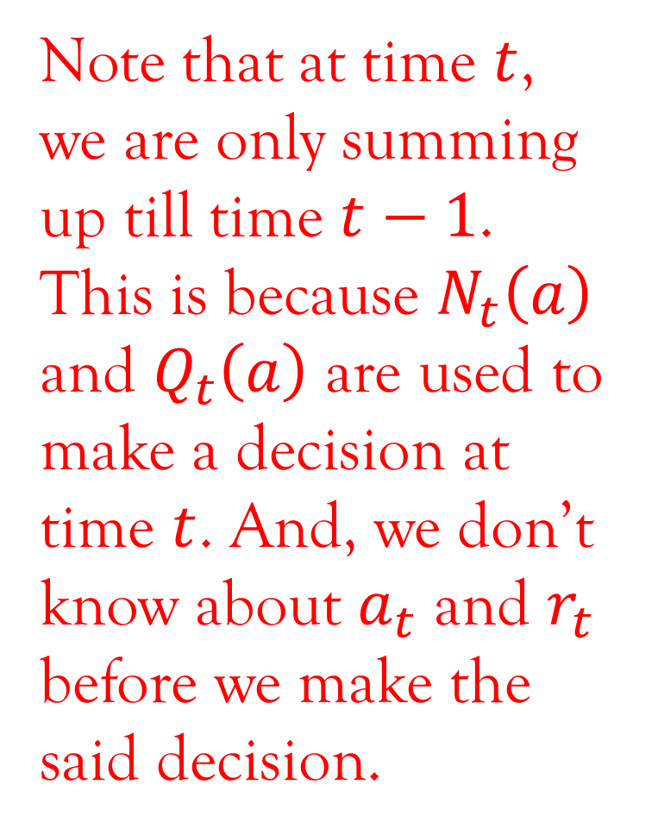
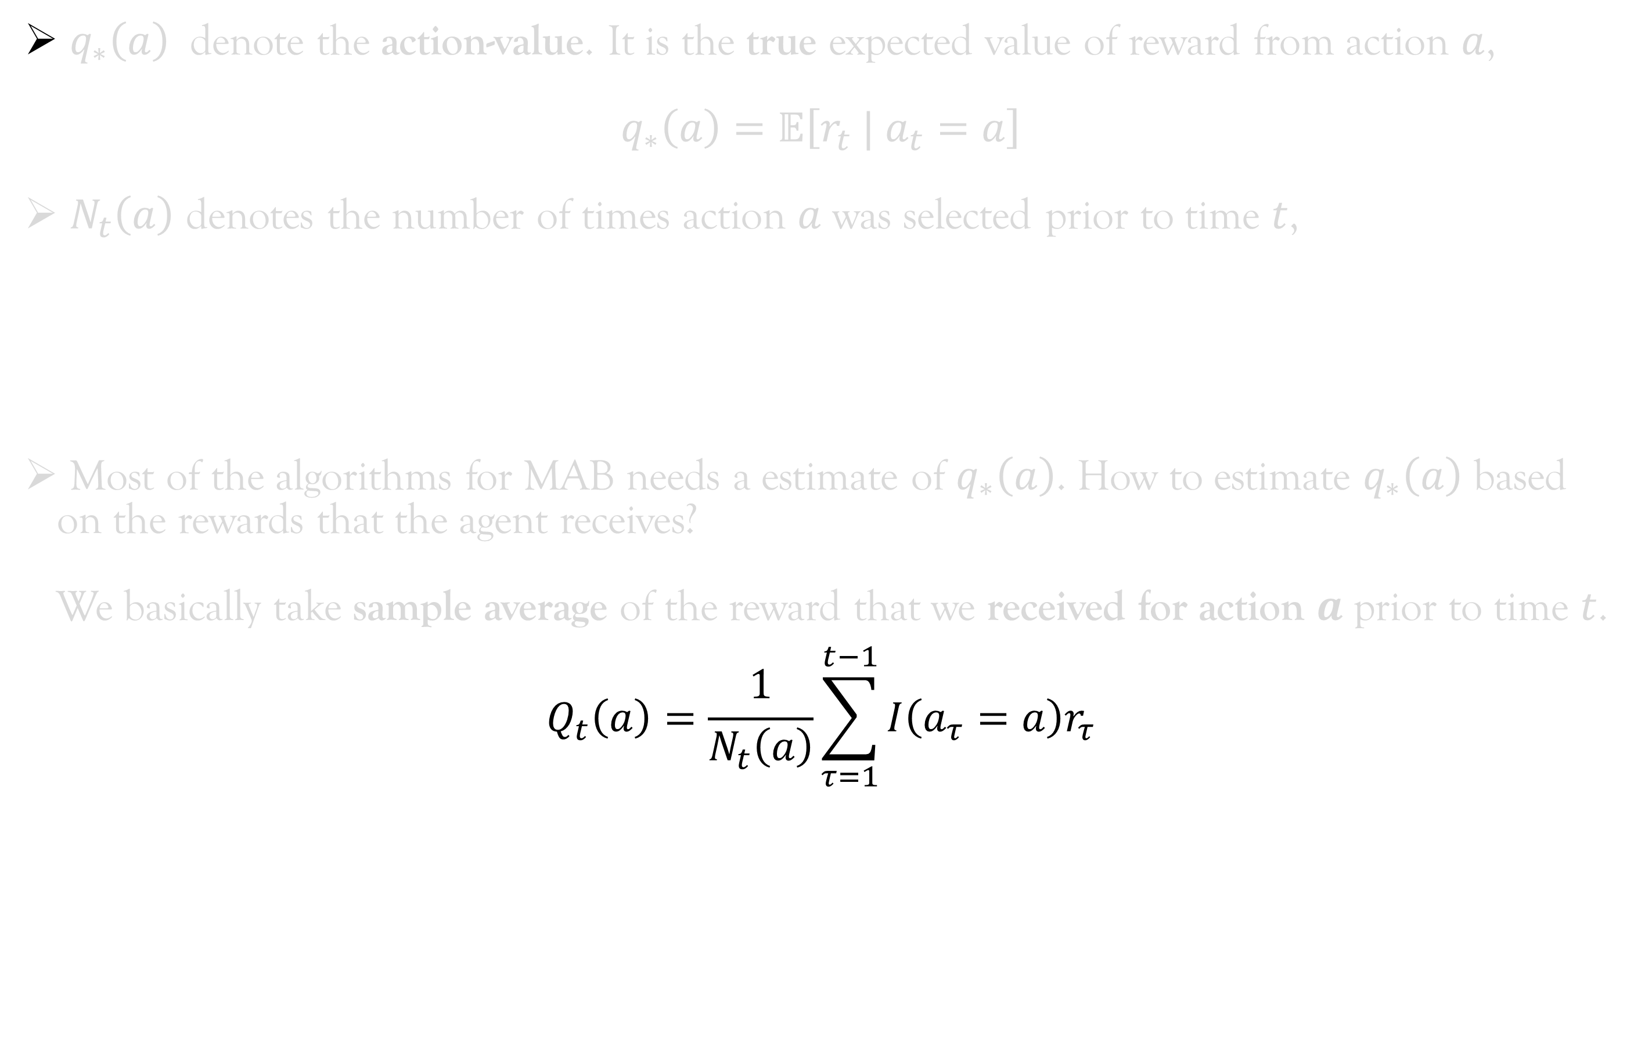
Mathematical Notations and Concepts
$q_{∗}\left(a\right)$ denote the action-value. It is the true expected value of reward from action $a$,
$$q_{∗}\left(a\right)=𝔼\left[r_{t} | a_{t}=a\right]$$
$N_{t}\left(a\right)$ denotes the number of times action $a$ was selected prior to time $t$,
Most of the algorithms for MAB needs a estimate of $q_{∗}\left(a\right)$. How to estimate $q_{∗}\left(a\right)$ based on the rewards that the agent receives?
We basically take sample average of the reward that we received for action $a$ prior to time $t$.
$$Q_{t}\left(a\right)=\frac{1}{N_{t}\left(a\right)}\sum_{τ=1}^{t−1}{I\left(a_{τ}=a\right)r_{τ}}$$
Note that at time $t$, we are only summing up till time $t−1$. This is because $N_{t}\left(a\right)$ and $Q_{t}\left(a\right)$ are used to make a decision at time $t$. And, we don’t know about $a_{t}$ and $r_{t}$ before we make the said decision.
$$N_{t}\left(a\right)=\sum_{τ=1}^{t−1}{I\left(a_{τ}=a\right)}$$
Indicator function

Slide 22
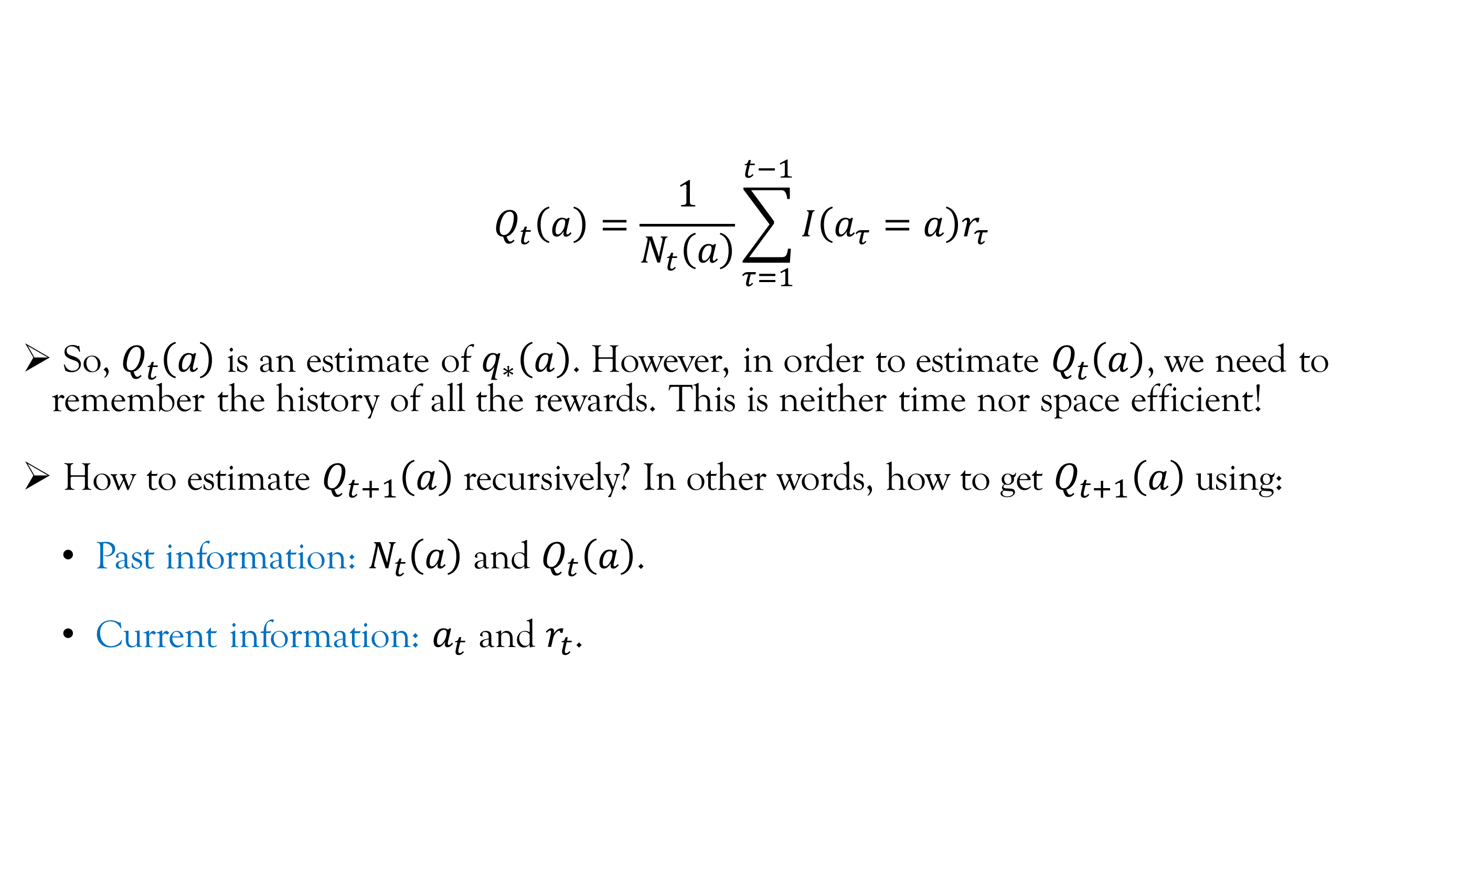
Mathematical Notations and Concepts
$$Q_{t}\left(a\right)=\frac{1}{N_{t}\left(a\right)}\sum_{τ=1}^{t−1}{I\left(a_{τ}=a\right)r_{τ}}$$
So, $Q_{t}\left(a\right)$ is an estimate of $q_{∗}\left(a\right)$. However, in order to estimate $Q_{t}\left(a\right)$, we need to remember the history of all the rewards. This is neither time nor space efficient!
How to estimate $Q_{t+1}\left(a\right)$ recursively? In other words, how to get $Q_{t+1}\left(a\right)$ using:
Past information: $N_{t}\left(a\right)$ and $Q_{t}\left(a\right)$.
Current information: $a_{t}$ and $r_{t}$.

Slide 23
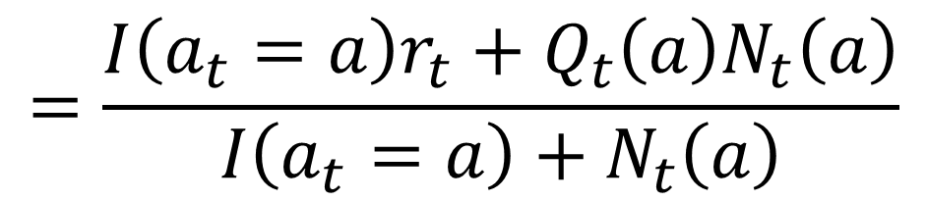
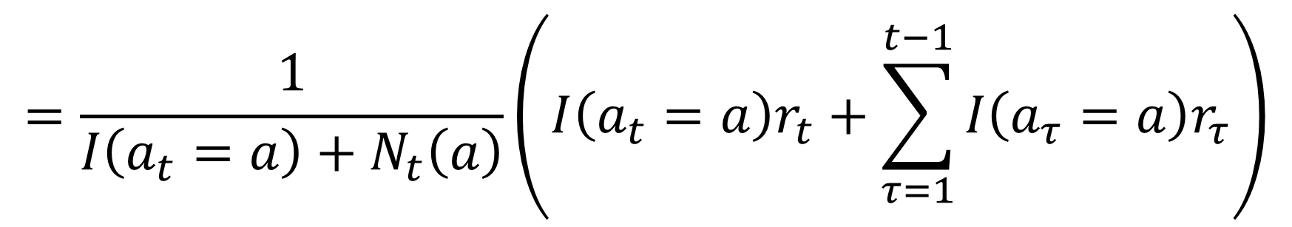
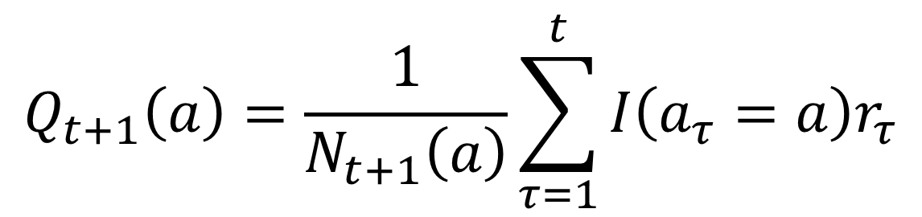
Mathematical Notations and Concepts
$$Q_{t+1}\left(a\right)=\frac{1}{N_{t+1}\left(a\right)}\sum_{τ=1}^{t}{I\left(a_{τ}=a\right)r_{τ}}$$
$$=\frac{1}{{I\left(a_{t}=a\right)+N}_{t}\left(a\right)}\left(I\left(a_{t}=a\right)r_{t}+\sum_{τ=1}^{t−1}{I\left(a_{τ}=a\right)r_{τ}}\right)$$
$$=\frac{I\left(a_{t}=a\right)r_{t}+Q_{t}\left(a\right)N_{t}\left(a\right)}{{I\left(a_{t}=a\right)+N}_{t}\left(a\right)}$$

Slide 24
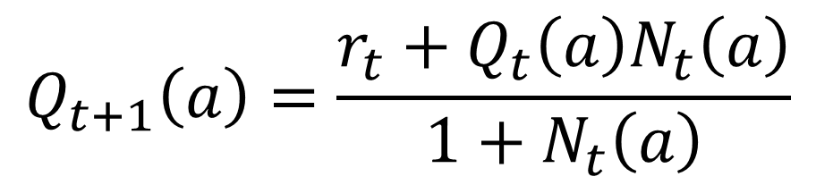
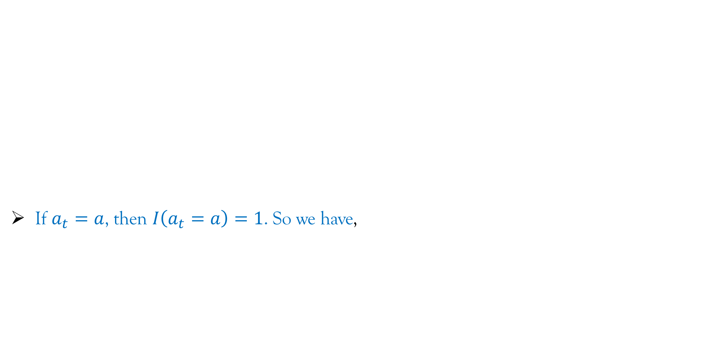
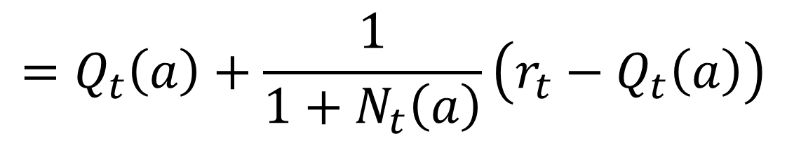
Mathematical Notations and Concepts
$$Q_{t+1}\left(a\right)=\frac{1}{N_{t+1}\left(a\right)}\sum_{τ=1}^{t}{I\left(a_{τ}=a\right)r_{τ}}$$
If $a_{t}=a$, then $I\left(a_{t}=a\right)=1$. So we have,
$$=\frac{1}{{I\left(a_{t}=a\right)+N}_{t}\left(a\right)}\left(I\left(a_{t}=a\right)r_{t}+\sum_{τ=1}^{t−1}{I\left(a_{τ}=a\right)r_{τ}}\right)$$
$$=\frac{I\left(a_{t}=a\right)r_{t}+Q_{t}\left(a\right)N_{t}\left(a\right)}{{I\left(a_{t}=a\right)+N}_{t}\left(a\right)}$$
$$Q_{t+1}\left(a\right)=\frac{r_{t}+Q_{t}\left(a\right)N_{t}\left(a\right)}{{1+N}_{t}\left(a\right)}$$
$$=Q_{t}\left(a\right)+\frac{1}{{1+N}_{t}\left(a\right)}\left(r_{t}−Q_{t}\left(a\right)\right)$$

Slide 25
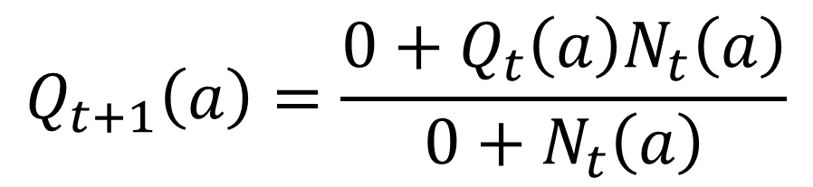

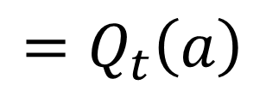
Mathematical Notations and Concepts
$$Q_{t+1}\left(a\right)=\frac{1}{N_{t+1}\left(a\right)}\sum_{τ=1}^{t}{I\left(a_{τ}=a\right)r_{τ}}$$
If $a_{t}≠a$, then $I\left(a_{t}=a\right)=0$. So we have,
$$=\frac{1}{{I\left(a_{t}=a\right)+N}_{t}\left(a\right)}\left(I\left(a_{t}=a\right)r_{t}+\sum_{τ=1}^{t−1}{I\left(a_{τ}=a\right)r_{τ}}\right)$$
$$=\frac{I\left(a_{t}=a\right)r_{t}+Q_{t}\left(a\right)N_{t}\left(a\right)}{{I\left(a_{t}=a\right)+N}_{t}\left(a\right)}$$
$$Q_{t+1}\left(a\right)=\frac{{0+Q}_{t}\left(a\right)N_{t}\left(a\right)}{{0+N}_{t}\left(a\right)}$$
$$=Q_{t}\left(a\right)$$

Slide 26
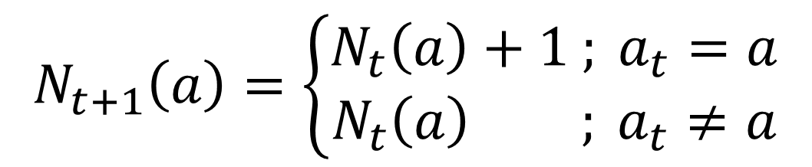
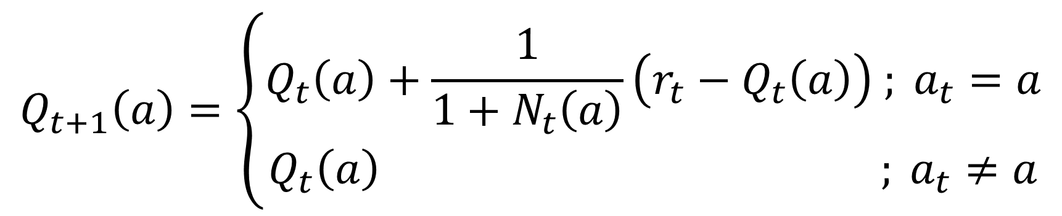
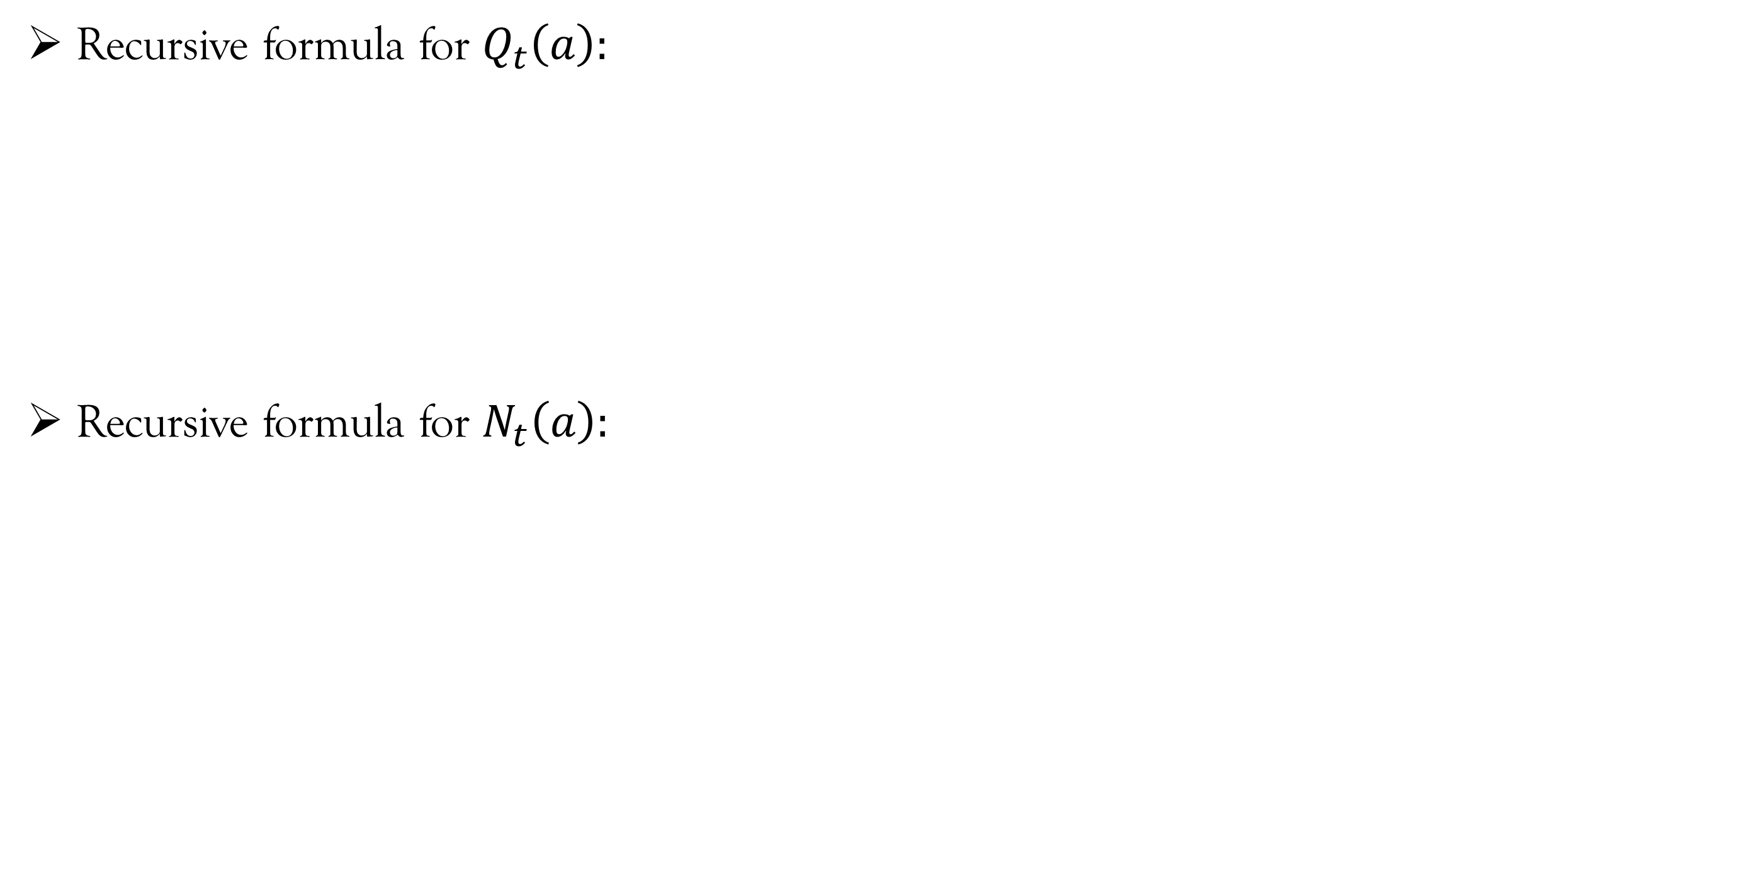
Mathematical Notations and Concepts
Recursive formula for $Q_{t}\left(a\right):$
Recursive formula for $N_{t}\left(a\right):$
$$Q_{t+1}\left(a\right)=\left\{\begin{aligned}Q_{t}\left(a\right)+\frac{1}{{1+N}_{t}\left(a\right)}\left(r_{t}−Q_{t}\left(a\right)\right) ; a_{t}=a \\ Q_{t}\left(a\right) ; a_{t}≠a\end{aligned}\right.$$
$$N_{t+1}\left(a\right)=\left\{\begin{aligned}N_{t}\left(a\right)+1 ; a_{t}=a \\ N_{t}\left(a\right) ; a_{t}≠a\end{aligned}\right.$$

Slide 27
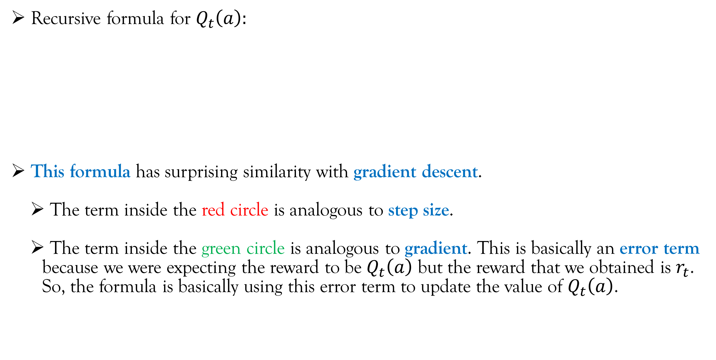
Mathematical Notations and Concepts
Recursive formula for $Q_{t}\left(a\right):$
This formula has surprising similarity with gradient descent.
The term inside the red circle is analogous to step size.
The term inside the green circle is analogous to gradient. This is basically an error term because we were expecting the reward to be $Q_{t}\left(a\right)$ but the reward that we obtained is $r_{t}$. So, the formula is basically using this error term to update the value of $Q_{t}\left(a\right)$.
$$Q_{t+1}\left(a\right)=\left\{\begin{aligned}Q_{t}\left(a\right)+\frac{1}{{1+N}_{t}\left(a\right)}\left(r_{t}−Q_{t}\left(a\right)\right) ; a_{t}=a \\ Q_{t}\left(a\right) ; a_{t}≠a\end{aligned}\right.$$

Slide 28
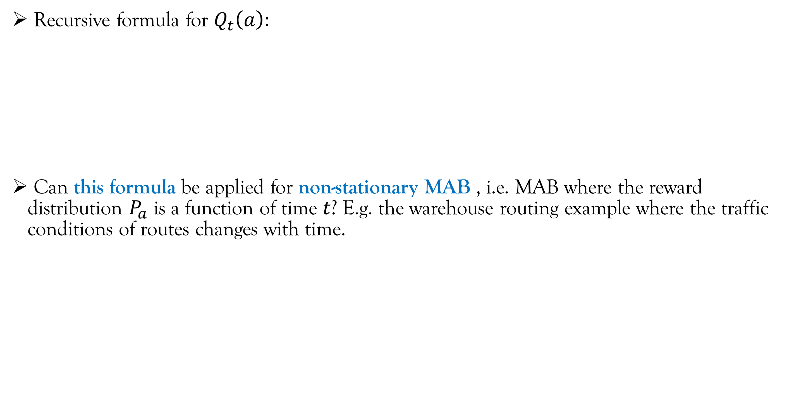
Mathematical Notations and Concepts
Recursive formula for $Q_{t}\left(a\right):$
Can this formula be applied for non-stationary MAB , i.e. MAB where the reward distribution $P_{a}$ is a function of time $t$? E.g. the warehouse routing example where the traffic conditions of routes changes with time.
$$Q_{t+1}\left(a\right)=\left\{\begin{aligned}Q_{t}\left(a\right)+\frac{1}{{1+N}_{t}\left(a\right)}\left(r_{t}−Q_{t}\left(a\right)\right) ; a_{t}=a \\ Q_{t}\left(a\right) ; a_{t}≠a\end{aligned}\right.$$

Slide 29
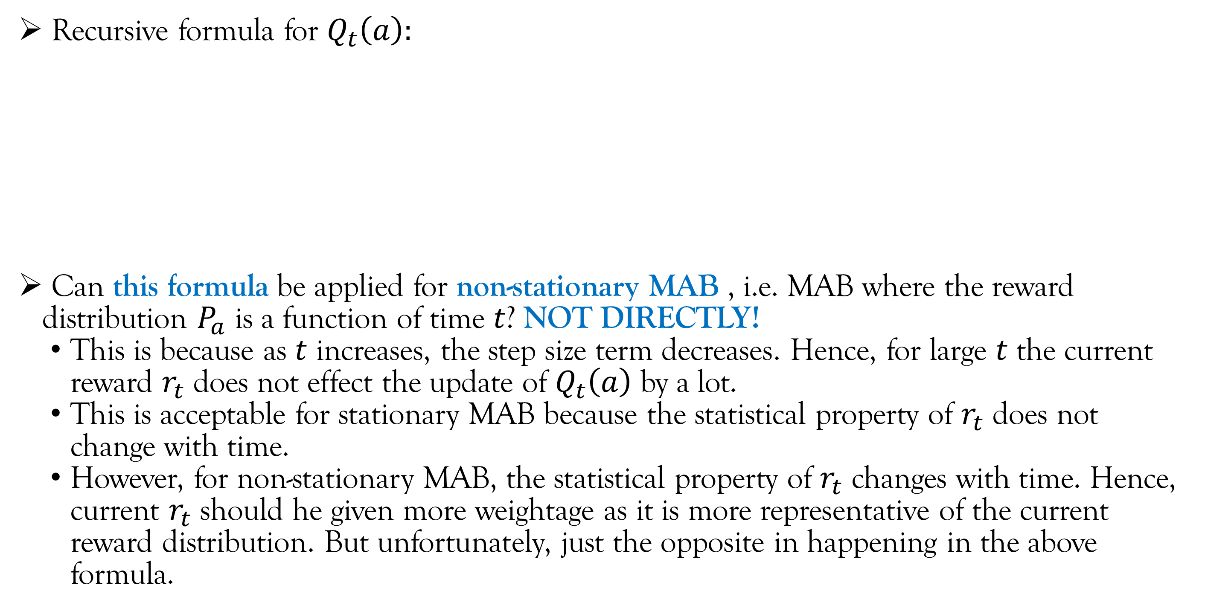
Mathematical Notations and Concepts
Recursive formula for $Q_{t}\left(a\right):$
Can this formula be applied for non-stationary MAB , i.e. MAB where the reward distribution $P_{a}$ is a function of time $t$? NOT DIRECTLY!
This is because as $t$ increases, the step size term decreases. Hence, for large $t$ the current reward $r_{t}$ does not effect the update of $Q_{t}\left(a\right)$ by a lot.
This is acceptable for stationary MAB because the statistical property of $r_{t}$ does not change with time.
However, for non-stationary MAB, the statistical property of $r_{t}$ changes with time. Hence, current $r_{t}$ should he given more weightage as it is more representative of the current reward distribution. But unfortunately, just the opposite in happening in the above formula.
$$Q_{t+1}\left(a\right)=\left\{\begin{aligned}Q_{t}\left(a\right)+\frac{1}{{1+N}_{t}\left(a\right)}\left(r_{t}−Q_{t}\left(a\right)\right) ; a_{t}=a \\ Q_{t}\left(a\right) ; a_{t}≠a\end{aligned}\right.$$

Slide 30
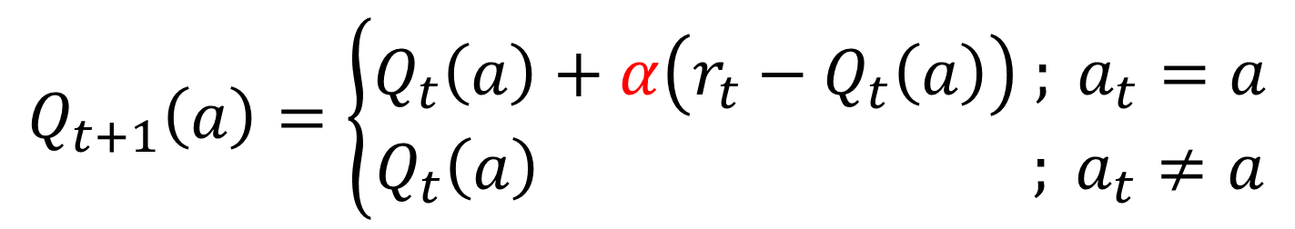
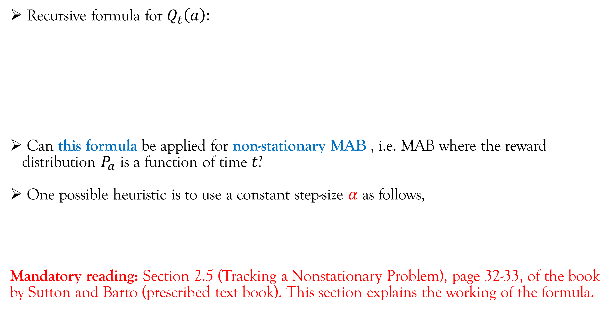
Mathematical Notations and Concepts
Recursive formula for $Q_{t}\left(a\right):$
Can this formula be applied for non-stationary MAB , i.e. MAB where the reward distribution $P_{a}$ is a function of time $t$?
One possible heuristic is to use a constant step-size $α$ as follows,
Mandatory reading: Section 2.5 (Tracking a Nonstationary Problem), page 32-33, of the book by Sutton and Barto (prescribed text book). This section explains the working of the formula.
$$Q_{t+1}\left(a\right)=\left\{\begin{aligned}Q_{t}\left(a\right)+\frac{1}{{1+N}_{t}\left(a\right)}\left(r_{t}−Q_{t}\left(a\right)\right) ; a_{t}=a \\ Q_{t}\left(a\right) ; a_{t}≠a\end{aligned}\right.$$
$$Q_{t+1}\left(a\right)=\left\{\begin{aligned}Q_{t}\left(a\right)+α\left(r_{t}−Q_{t}\left(a\right)\right) ; a_{t}=a \\ Q_{t}\left(a\right) ; a_{t}≠a\end{aligned}\right.$$

Slide 31
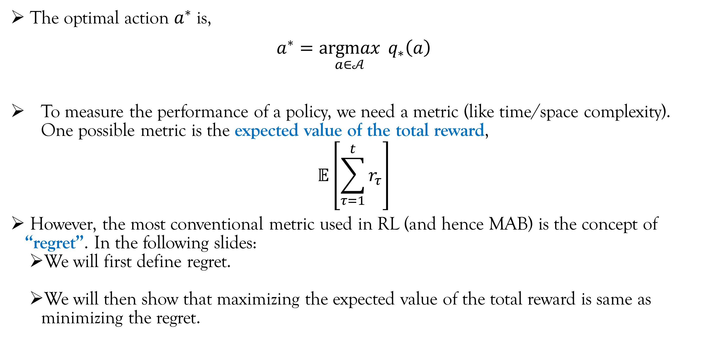
Mathematical Notations and Concepts
The optimal action $a^{∗}$ is,
$$a^{∗}=\underset{a∈𝒜}{argmax}{{ q}_{∗}\left(a\right)}$$
To measure the performance of a policy, we need a metric (like time/space complexity). One possible metric is the expected value of the total reward,
$$𝔼\left[\sum_{τ=1}^{t}{r_{τ}}\right]$$
However, the most conventional metric used in RL (and hence MAB) is the concept of “regret”. In the following slides:
We will first define regret.
We will then show that maximizing the expected value of the total reward is same as minimizing the regret.

Slide 32
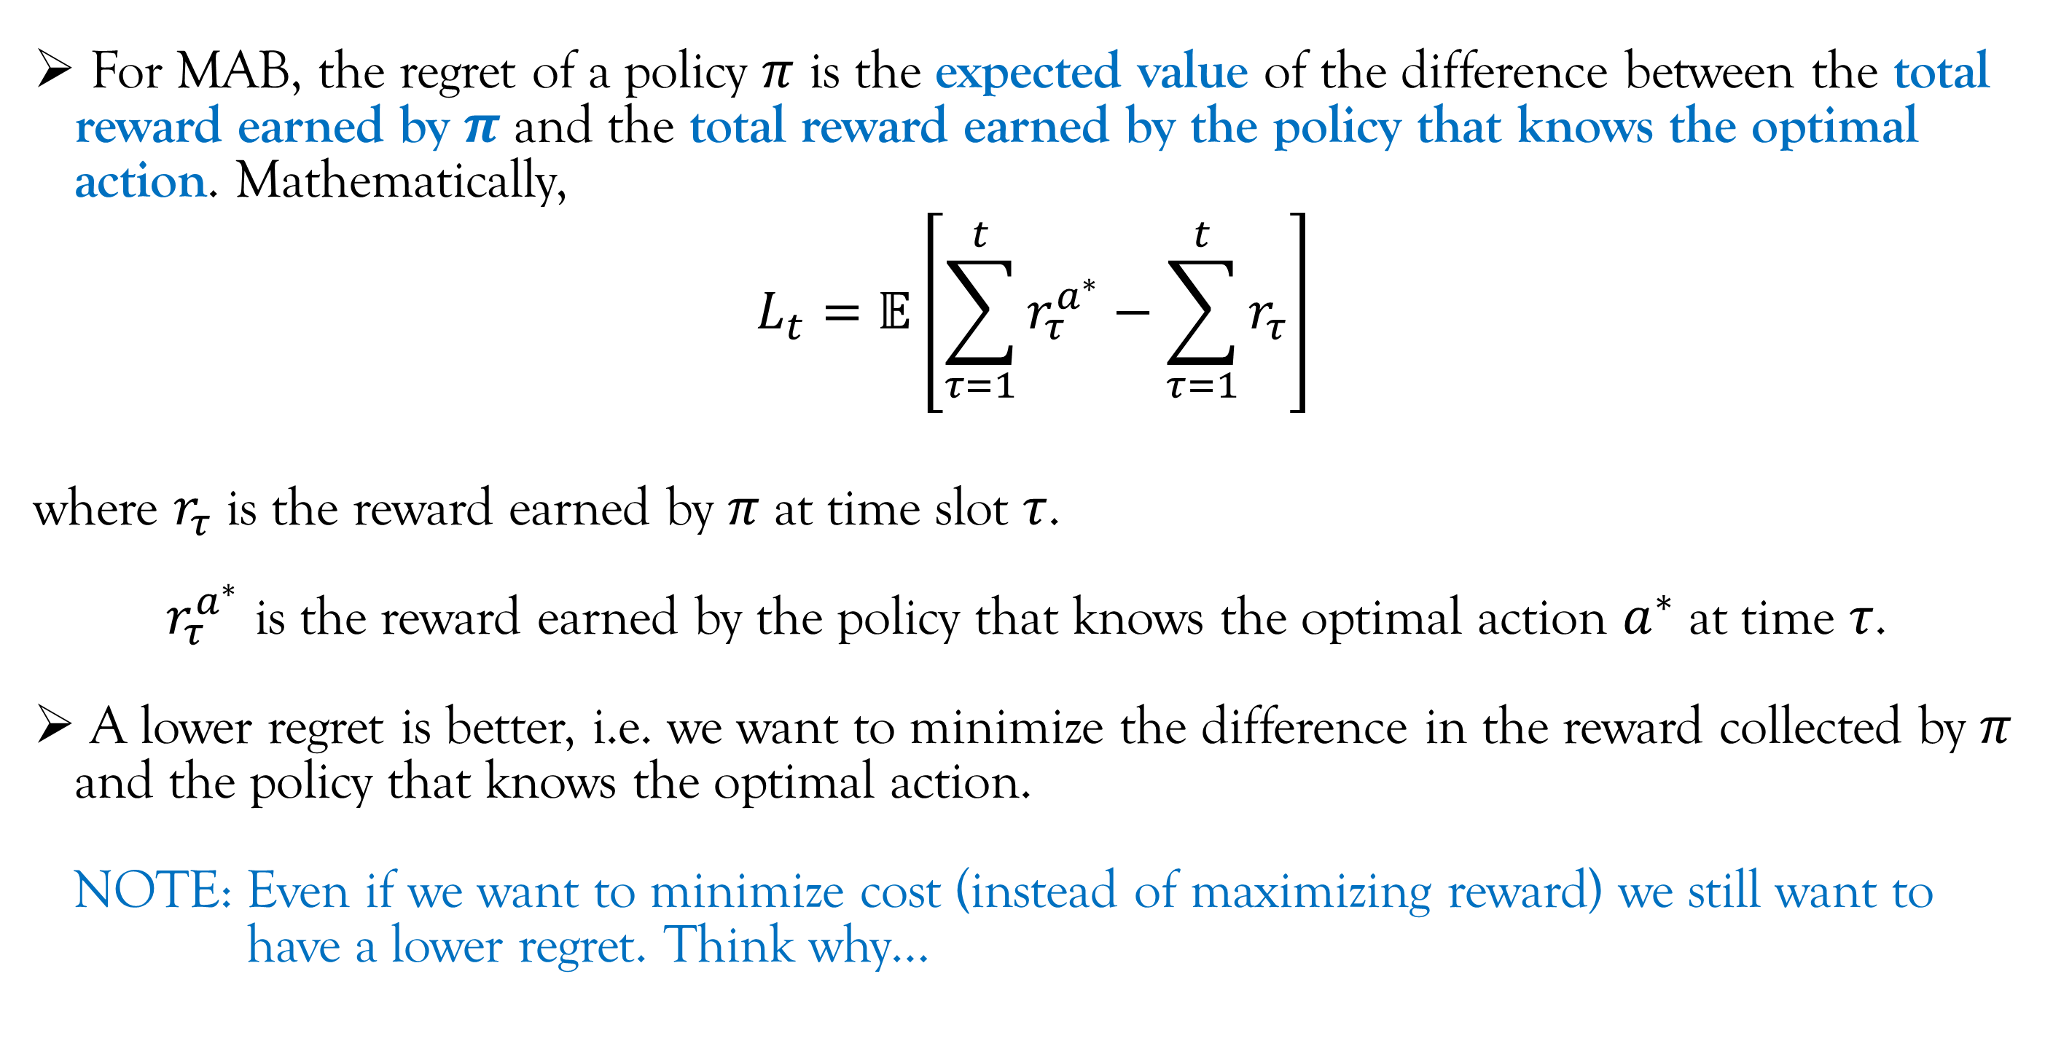
Mathematical Notations and Concepts
For MAB, the regret of a policy $π$ is the expected value of the difference between the total reward earned by $π$ and the total reward earned by the policy that knows the optimal action. Mathematically,
$$L_{t}=𝔼\left[\sum_{τ=1}^{t}{r_{τ}^{a^{∗}}}−\sum_{τ=1}^{t}{r_{τ}}\right]$$
where $r_{τ}$ is the reward earned by $π$ at time slot $τ$.
$r_{τ}^{a^{∗}}$ is the reward earned by the policy that knows the optimal action $a^{∗}$ at time $τ$.
A lower regret is better, i.e. we want to minimize the difference in the reward collected by $π$ and the policy that knows the optimal action.
NOTE: Even if we want to minimize cost (instead of maximizing reward) we still want to
have a lower regret. Think why…

Slide 33
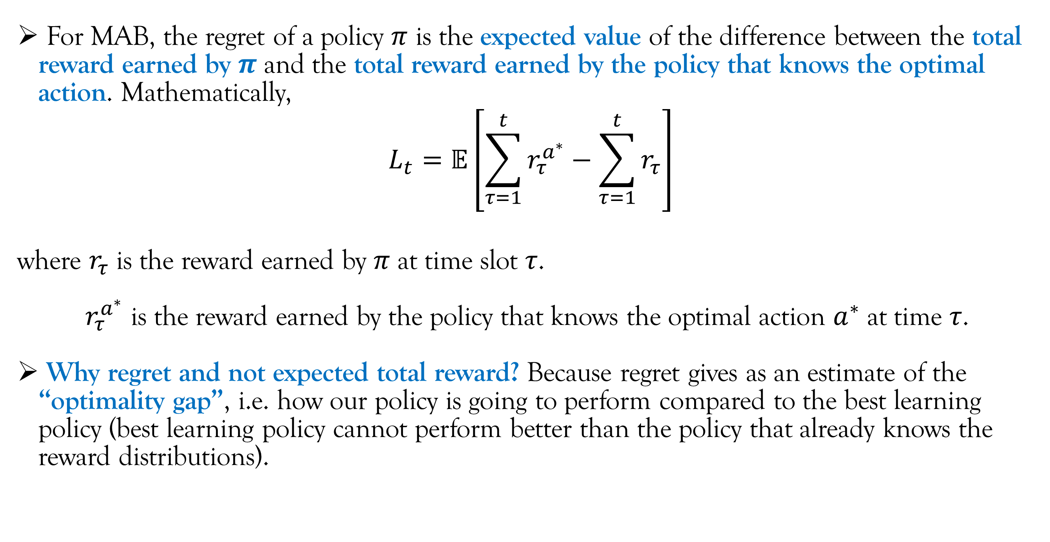
Mathematical Notations and Concepts
For MAB, the regret of a policy $π$ is the expected value of the difference between the total reward earned by $π$ and the total reward earned by the policy that knows the optimal action. Mathematically,
$$L_{t}=𝔼\left[\sum_{τ=1}^{t}{r_{τ}^{a^{∗}}}−\sum_{τ=1}^{t}{r_{τ}}\right]$$
where $r_{τ}$ is the reward earned by $π$ at time slot $τ$.
$r_{τ}^{a^{∗}}$ is the reward earned by the policy that knows the optimal action $a^{∗}$ at time $τ$.
Why regret and not expected total reward? Because regret gives as an estimate of the “optimality gap”, i.e. how our policy is going to perform compared to the best learning policy (best learning policy cannot perform better than the policy that already knows the reward distributions).

Slide 34
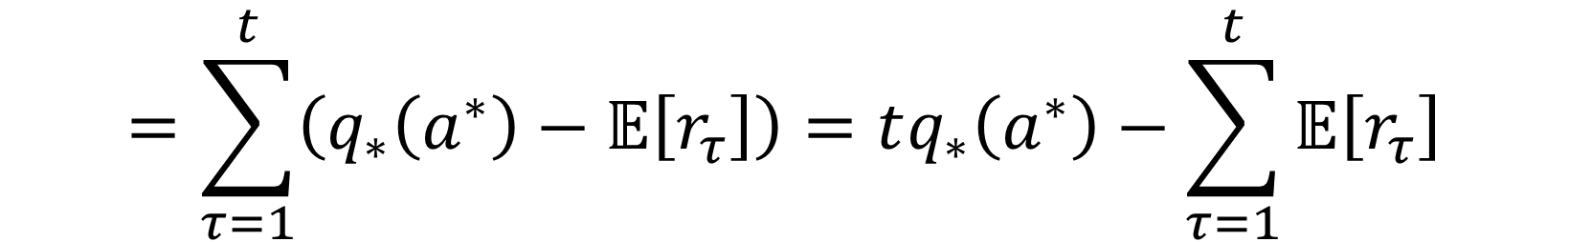
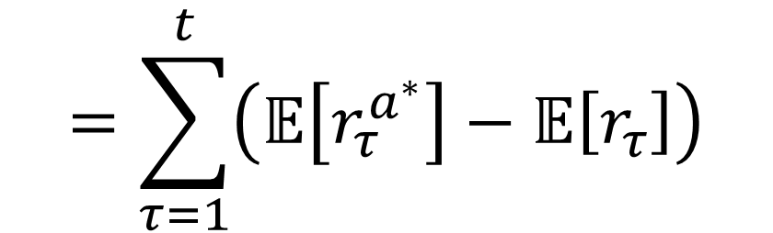
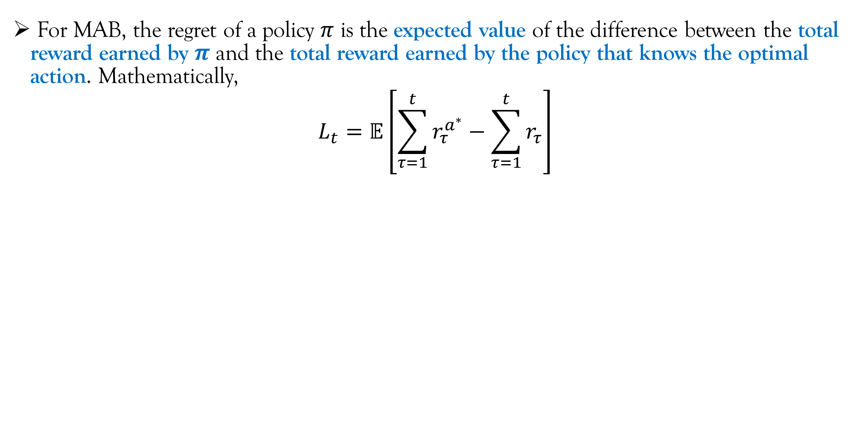
Mathematical Notations and Concepts
For MAB, the regret of a policy $π$ is the expected value of the difference between the total reward earned by $π$ and the total reward earned by the policy that knows the optimal action. Mathematically,
$$L_{t}=𝔼\left[\sum_{τ=1}^{t}{r_{τ}^{a^{∗}}}−\sum_{τ=1}^{t}{r_{τ}}\right]$$
The expected value of total reward.
$$=\sum_{τ=1}^{t}{\left(𝔼\left[r_{τ}^{a^{∗}}\right]−𝔼\left[r_{τ}\right]\right)}$$
This is a constant term.
$$=\sum_{τ=1}^{t}{\left(q_{∗}\left(a^{∗}\right)−𝔼\left[r_{τ}\right]\right)}=tq_{∗}\left(a^{∗}\right)−\sum_{τ=1}^{t}{𝔼\left[r_{τ}\right]}$$

Slide 35
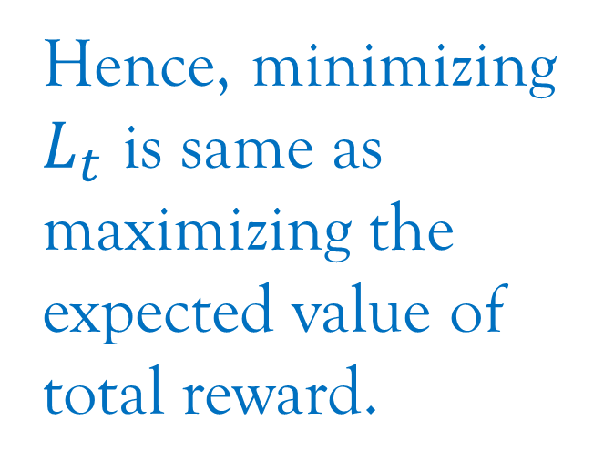
Mathematical Notations and Concepts
For MAB, the regret of a policy $π$ is the expected value of the difference between the total reward earned by $π$ and the total reward earned by the policy that knows the optimal action. Mathematically,
$$L_{t}=𝔼\left[\sum_{τ=1}^{t}{r_{τ}^{a^{∗}}}−\sum_{τ=1}^{t}{r_{τ}}\right]$$
Hence, minimizing $L_{t}$ is same as maximizing the expected value of total reward.
$$=\sum_{τ=1}^{t}{\left(𝔼\left[r_{τ}^{a^{∗}}\right]−𝔼\left[r_{τ}\right]\right)}$$
$$=\sum_{τ=1}^{t}{\left(q_{∗}\left(a^{∗}\right)−𝔼\left[r_{τ}\right]\right)}=tq_{∗}\left(a^{∗}\right)−\sum_{τ=1}^{t}{𝔼\left[r_{τ}\right]}$$

Slide 36
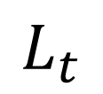
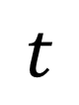
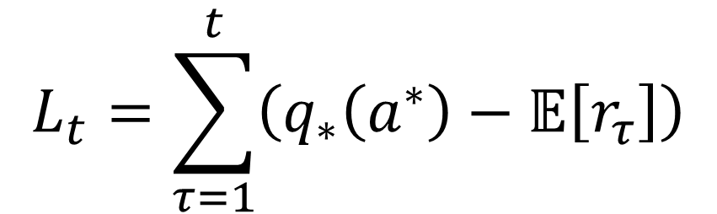
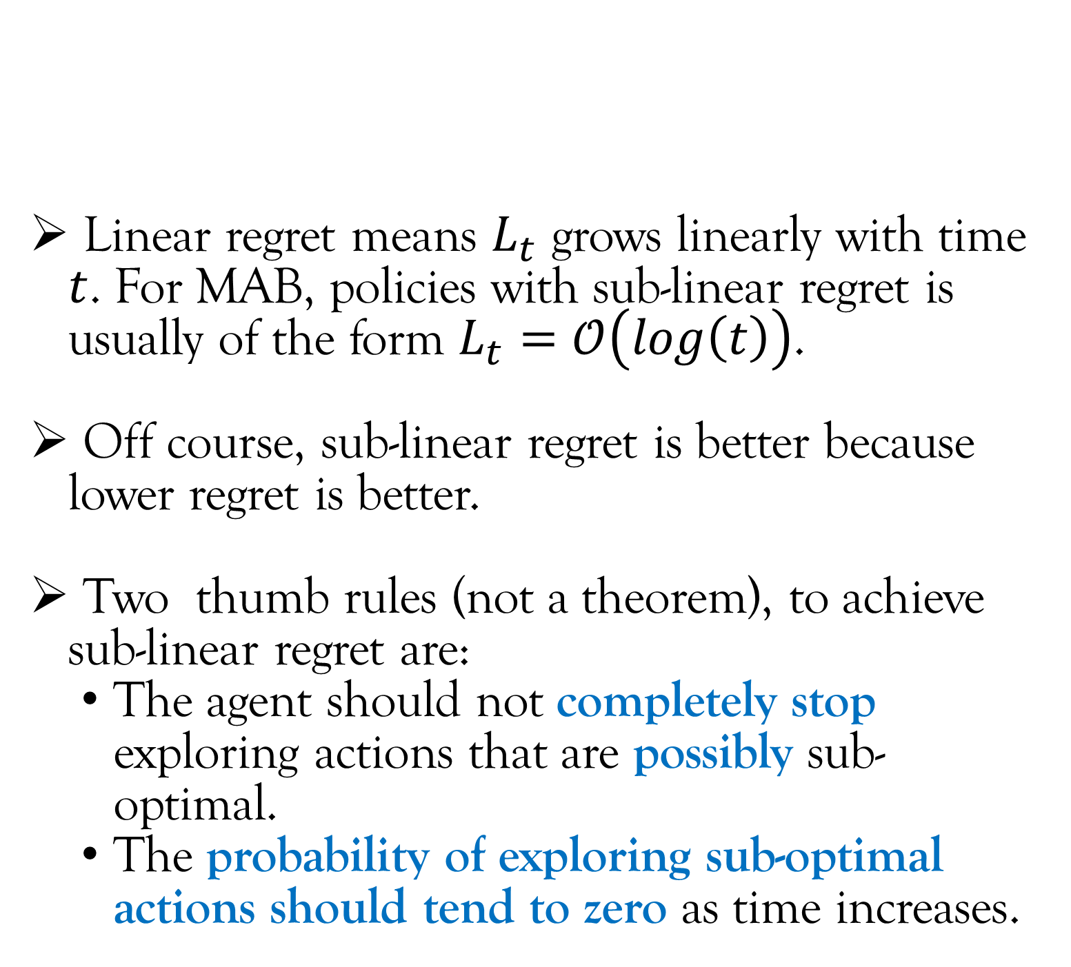
Mathematical Notations and Concepts
$$L_{t}=\sum_{τ=1}^{t}{\left(q_{∗}\left(a^{∗}\right)−𝔼\left[r_{τ}\right]\right)}$$
Linear regret means $L_{t}$ grows linearly with time $t$. For MAB, policies with sub-linear regret is usually of the form $L_{t}=𝒪\left(log\left(t\right)\right)$.
Off course, sub-linear regret is better because lower regret is better.
Two thumb rules (not a theorem), to achieve sub-linear regret are:
The agent should not completely stop exploring actions that are possibly sub-optimal.
The probability of exploring sub-optimal actions should tend to zero as time increases.
$$L_{t}$$
$$t$$
Linear regret
Sublinear regret

Slide 37

Mathematical Notations and Concepts
$$L_{t}=\sum_{τ=1}^{t}{\left(q_{∗}\left(a^{∗}\right)−𝔼\left[r_{τ}\right]\right)}$$
Linear regret means $L_{t}$ grows linearly with time $t$. For MAB, policies with sub-linear regret is usually of the form $L_{t}=𝒪\left(log\left(t\right)\right)$.
Off course, sub-linear regret is better because lower regret is better.
A good chunk of theoretical work in reinforcement learning (including MAB) involves deriving the formula for regret. In this course, we will only evaluate regret (among other performance measures like time-average expected reward) using simulations.
(Explain about average reward and steady state)
$$L_{t}$$
$$t$$
Linear regret
Sublinear regret

Slide 38

Mathematical Notations and Concepts
An alternate perspective of linear and sub-linear regret
Consider $\frac{L_{t}}{t}$. This quantity is the average error in reward between the policy that know the best arm and the policy $π$. From the perspective of control theory, this is the steady state error.
If the policy $π$ has a linear regret, then $L_{t}≈δt$
for large $t$. Then, $\frac{L_{t}}{t}≈δ$; a finite error even as
$t$ tends to infinity.
$$L_{t}$$
$$t$$
Linear regret
Sublinear regret

Slide 39

Mathematical Notations and Concepts
An alternate perspective of linear and sub-linear regret
Consider $\frac{L_{t}}{t}$. This quantity is the average error in reward between the policy that know the best arm and the policy $π$. From the perspective of control theory, this is the steady state error.
If the policy $π$ has a sub-linear regret $𝒪\left(log\left(t\right)\right)$,
then $L_{t}≈δlog\left(t\right)$ for large $t$. Then,
$\frac{L_{t}}{t}≈\frac{δlog\left(t\right)}{t}$ which tends to $0$ as $t$ tends to
infinity.
$$L_{t}$$
$$t$$
Linear regret
Sublinear regret

Slide 40

Lecture Content
The Multi-Armed Bandit* (MAB) setup.
A Fundamental Tradeoff.
Mathematical Notations and Concepts.
Policies for Multi-Armed Bandit
$ε$-greedy policy.
Upper Confidence Bound policy.
Policy gradient.
*PLEASE NOTE: Multi-Armed Bandit by default means the “simple Multi-Armed Bandit” and NOT “contextual Multi-Armed Bandit”.

Slide 41


$ε−$Greedy Policy
As we discussed a little while before, there is a need to balance exploration and exploitation.
We decide this “balance” using a probability parameter $ε∈\left(0,1\right)$. To elaborate:
Explore with a probability of $ε$.
Exploit with a probability of $1−ε$.

Slide 42

$ε−$Greedy Policy
As we discussed a little while before, there is a need to balance exploration and exploitation.
We decide this “balance” using a probability parameter $ε∈\left(0,1\right)$. To elaborate:
Explore with a probability of $ε$.
Exploit with a probability of $1−ε$.
A confusing attribute about the algorithm name: Greedy is synonymous to exploitation. So logically it is intuitive to think that $ε−$greedy means:
Exploit with a probability of $ε$.
Explore with a probability of $1−ε$.
Interchanged

Slide 43

$ε−$Greedy Policy
As we discussed a little while before, there is a need to balance exploration and exploitation.
We decide this “balance” using a probability parameter $ε∈\left(0,1\right)$. To elaborate:
Explore with a probability of $ε$.
Exploit with a probability of $1−ε$.
At time $t$:
Sample a random variable $x$ between $0$ to $1$ from a uniform distribution.
If $x≤ε$:
$a_{t}$ is chosen uniformly at random from $𝒜$.
Else:
$a_{t}=\underset{a∈𝒜}{argmax}{Q_{t}\left(a\right)}$
Based on the action chosen, the agent will receive a reward $r_{t}\sim P_{a_{t}}$ from the environment.
Update $Q_{t+1}\left(a\right)$ and $N_{t+1}\left(a\right)$ for all $a∈𝒜$ based on action $a_{t}$ and reward $r_{t}$.
This is NOT a pseudocode. Refer page 32 of “the book” for the pseudocode.

Slide 44

$ε−$Greedy Policy
As we discussed a little while before, there is a need to balance exploration and exploitation.
We decide this “balance” using a probability parameter $ε∈\left(0,1\right)$. To elaborate:
Explore with a probability of $ε$.
Exploit with a probability of $1−ε$.
At time $t$:
Sample a random variable $x$ between $0$ to $1$ from a uniform distribution.
If $x≤ε$:
$a_{t}$ is chosen uniformly at random from $𝒜$.
Else:
$a_{t}=\underset{a∈𝒜}{argmax}{Q_{t}\left(a\right)}$
Based on the action chosen, the agent will receive a reward $r_{t}\sim P_{a_{t}}$ from the environment.
Update $Q_{t+1}\left(a\right)$ and $N_{t+1}\left(a\right)$ for all $a∈𝒜$ based on action $a_{t}$ and reward $r_{t}$.
$$x=np.random.uniform(0,1)$$

Slide 45




$ε−$Greedy Policy
As we discussed a little while before, there is a need to balance exploration and exploitation.
We decide this “balance” using a probability parameter $ε∈\left(0,1\right)$. To elaborate:
Explore with a probability of $ε$.
Exploit with a probability of $1−ε$.
At time $t$:
Sample a random variable $x$ between $0$ to $1$ from a uniform distribution.
If $x≤ε$:
$a_{t}$ is chosen uniformly at random from $𝒜$. (Exploration step)
Else:
$a_{t}=\underset{a∈𝒜}{argmax}{Q_{t}\left(a\right)}$ (Exploitation step)
Based on the action chosen, the agent will receive a reward $r_{t}\sim P_{a_{t}}$ from the environment.
Update $Q_{t+1}\left(a\right)$ and $N_{t+1}\left(a\right)$ for all $a∈𝒜$ based on action $a_{t}$ and reward $r_{t}$.
$$ε$$
$$x$$
$$1−ε$$
Explore
Exploit

Slide 46
$ε−$Greedy Policy
As we discussed a little while before, there is a need to balance exploration and exploitation.
We decide this “balance” using a probability parameter $ε∈\left(0,1\right)$. To elaborate:
Explore with a probability of $ε$.
Exploit with a probability of $1−ε$.
At time $t$:
Sample a random variable $x$ between $0$ to $1$ from a uniform distribution.
If $x≤ε$:
$a_{t}$ is chosen uniformly at random from $𝒜$. (Exploration step)
Else:
$a_{t}=\underset{a∈𝒜}{argmax}{Q_{t}\left(a\right)}$ (Exploitation step)
Based on the action chosen, the agent will receive a reward $r_{t}\sim P_{a_{t}}$ from the environment.
Update $Q_{t+1}\left(a\right)$ and $N_{t+1}\left(a\right)$ for all $a∈𝒜$ based on action $a_{t}$ and reward $r_{t}$.
$$x=np.random.randint(1,A+1)$$
The set of all actions, $𝒜=\left\{1,2,…,A\right\}$

Slide 47

$ε−$Greedy Policy
As we discussed a little while before, there is a need to balance exploration and exploitation.
We decide this “balance” using a probability parameter $ε∈\left(0,1\right)$. To elaborate:
Explore with a probability of $ε$.
Exploit with a probability of $1−ε$.
At time $t$:
Sample a random variable $x$ between $0$ to $1$ from a uniform distribution.
If $x≤ε$:
$a_{t}$ is chosen uniformly at random from $𝒜$. (Exploration step)
Else:
$a_{t}=\underset{a∈𝒜}{argmax}{Q_{t}\left(a\right)}$ (Exploitation step)
Based on the action chosen, the agent will receive a reward $r_{t}\sim P_{a_{t}}$ from the environment.
Update $Q_{t+1}\left(a\right)$ and $N_{t+1}\left(a\right)$ for all $a∈𝒜$ based on action $a_{t}$ and reward $r_{t}$.
Choose the action with the highest sample average reward.

Slide 48
$ε−$Greedy Policy
As we discussed a little while before, there is a need to balance exploration and exploitation.
We decide this “balance” using a probability parameter $ε∈\left(0,1\right)$. To elaborate:
Explore with a probability of $ε$.
Exploit with a probability of $1−ε$.
At time $t$:
Sample a random variable $x$ between $0$ to $1$ from a uniform distribution.
If $x≤ε$:
$a_{t}$ is chosen uniformly at random from $𝒜$.
Else:
$a_{t}=\underset{a∈𝒜}{argmax}{Q_{t}\left(a\right)}$
Based on the action chosen, the agent will receive a reward $r_{t}\sim P_{a_{t}}$ from the environment.
Update $Q_{t+1}\left(a\right)$ and $N_{t+1}\left(a\right)$ for all $a∈𝒜$ based on action $a_{t}$ and reward $r_{t}$.
In real world, this step is not part of the agents policy; the environment will give a reward.

Slide 49


$ε−$Greedy Policy
As we discussed a little while before, there is a need to balance exploration and exploitation.
We decide this “balance” using a probability parameter $ε∈\left(0,1\right)$. To elaborate:
Explore with a probability of $ε$.
Exploit with a probability of $1−ε$.
At time $t$:
Sample a random variable $x$ between $0$ to $1$ from a uniform distribution.
If $x≤ε$:
$a_{t}$ is chosen uniformly at random from $𝒜$.
Else:
$a_{t}=\underset{a∈𝒜}{argmax}{Q_{t}\left(a\right)}$
Based on the action chosen, the agent will receive a reward $r_{t}\sim P_{a_{t}}$ from the environment.
Update $Q_{t+1}\left(a\right)$ and $N_{t+1}\left(a\right)$ for all $a∈𝒜$ based on action $a_{t}$ and reward $r_{t}$.
When we are trying to simulate the real world, we have to sample the reward from distribution $P_{a_{t}}$.
If $P_{a_{t}}$ is a distribution of discrete random variable, you can use np.random.choice(). Else, I taught you a way in previous lecture.

Slide 50

$ε−$Greedy Policy
As we discussed a little while before, there is a need to balance exploration and exploitation.
We decide this “balance” using a probability parameter $ε∈\left(0,1\right)$. To elaborate:
Explore with a probability of $ε$.
Exploit with a probability of $1−ε$.
At time $t$:
Sample a random variable $x$ between $0$ to $1$ from a uniform distribution.
If $x≤ε$:
$a_{t}$ is chosen uniformly at random from $𝒜$.
Else:
$a_{t}=\underset{a∈𝒜}{argmax}{Q_{t}\left(a\right)}$
Based on the action chosen, the agent will receive a reward $r_{t}\sim P_{a_{t}}$ from the environment.
Update $Q_{t+1}\left(a\right)$ and $N_{t+1}\left(a\right)$ for all $a∈𝒜$ based on action $a_{t}$ and reward $r_{t}$.
Refer to slide 23.

Slide 51
$ε−$Greedy Policy
As we discussed a little while before, there is a need to balance exploration and exploitation.
We decide this “balance” using a probability parameter $ε∈\left(0,1\right)$. To elaborate:
Explore with a probability of $ε$.
Exploit with a probability of $1−ε$.
At time $t$:
Sample a random variable $x$ between $0$ to $1$ from a uniform distribution.
If $x≤ε$:
$a_{t}$ is chosen uniformly at random from $𝒜$.
Else:
$a_{t}=\underset{a∈𝒜}{argmax}{Q_{t}\left(a\right)}$
Based on the action chosen, the agent will receive a reward $r_{t}\sim P_{a_{t}}$ from the environment.
Update $Q_{t+1}\left(a\right)$ and $N_{t+1}\left(a\right)$ for all $a∈𝒜$ based on action $a_{t}$ and reward $r_{t}$.
IMPORTANT: This policy uses the estimate of the action-value to make decisions. Such policies are called “Value function” based policy.
Refer to slide 23.

Slide 52

$ε−$Greedy Policy
As we discussed a little while before, there is a need to balance exploration and exploitation.
We decide this “balance” using a probability parameter $ε∈\left(0,1\right)$. To elaborate:
Explore with a probability of $ε$.
Exploit with a probability of $1−ε$.
In practice, $ε$ is not a constant. Rather it varies with $t$, i.e. $ε_{t}$.
$ε_{t}$is high in the beginning to explore more.
As $t$ increases, the agent has a good idea above the action-value of all the arms. Hence, $ε_{t}$ decreases as $t$ increases.
We can choose our own custom strategy to change $ε_{t}$ but a common strategy is $ε_{t}=\frac{δ}{t^{n}}$ where $n=1,2,…$

Slide 53

$ε−$Greedy Policy
As we discussed a little while before, there is a need to balance exploration and exploitation.
We decide this “balance” using a probability parameter $ε∈\left(0,1\right)$. To elaborate:
Explore with a probability of $ε$.
Exploit with a probability of $1−ε$.
In practice, $ε$ is not a constant. Rather it varies with $t$, i.e. $ε_{t}$.
$ε_{t}$is high in the beginning to explore more.
As $t$ increases, the agent has a good idea above the action-value of all the arms. Hence, $ε_{t}$ decreases as $t$ increases.
We can choose our own custom strategy to change $ε_{t}$ but a common strategy is $ε_{t}=\frac{δ}{t^{n}}$ where $n=1,2,…$
This is similar to the decreases in step-size during training ML/DL models.

Slide 54

$ε−$Greedy Policy
As we discussed a little while before, there is a need to balance exploration and exploitation.
We decide this “balance” using a probability parameter $ε∈\left(0,1\right)$. To elaborate:
Explore with a probability of $ε$.
Exploit with a probability of $1−ε$.
In practice, $ε$ is not a constant. Rather it varies with $t$, i.e. $ε_{t}$.
$ε_{t}$is high in the beginning to explore more.
As $t$ increases, the agent has a good idea above the action-value of all the arms. Hence, $ε_{t}$ decreases as $t$ increases.
We can choose our own custom strategy to change $ε_{t}$ but a common strategy is $ε_{t}=\frac{δ}{t^{n}}$ where $n=1,2,…$
Even though $ε−$Greedy policy works very well in practice with varying $ε_{t}$, there is no theoretical proof of sublinear regret with varying $ε_{t}$.

Slide 55

Upper Confidence Bound (UCB) Policy
To implement this algorithm we must ensure that the rewards are between $\left[0,1\right]$. If not, them shift and scale.
At time $t$:
Set $a_{t}=\underset{a∈𝒜}{argmax}\left(Q_{t}\left(a\right)+\sqrt{\frac{2ln\left(t\right)}{N_{t}\left(a\right)}}\right)$.
Based on the action chosen, the agent will receive a reward $r_{t}\sim P_{a_{t}}$ from the environment.
Update $Q_{t+1}\left(a\right)$ and $N_{t+1}\left(a\right)$ for all $a∈𝒜$ based on action $a_{t}$ and reward $r_{t}$.

Slide 56

Upper Confidence Bound (UCB) Policy
To implement this algorithm we must ensure that the rewards are between $\left[0,1\right]$. If not, them shift and scale.
At time $t$:
Set $a_{t}=\underset{a∈𝒜}{argmax}\left(Q_{t}\left(a\right)+\sqrt{\frac{2ln\left(t\right)}{N_{t}\left(a\right)}}\right)$.
Based on the action chosen, the agent will receive a reward $r_{t}\sim P_{a_{t}}$ from the environment.
Update $Q_{t+1}\left(a\right)$ and $N_{t+1}\left(a\right)$ for all $a∈𝒜$ based on action $a_{t}$ and reward $r_{t}$.
Just like $ε−$Greedy policy, this policy also uses the estimate of the action-value to make decisions. Hence, it is a “Value function” based policy.

Slide 57

Upper Confidence Bound (UCB) Policy
To implement this algorithm we must ensure that the rewards are between $\left[0,1\right]$. If not, them shift and scale.
At time $t$:
Set $a_{t}=\underset{a∈𝒜}{argmax}\left(Q_{t}\left(a\right)+\sqrt{\frac{2ln\left(t\right)}{N_{t}\left(a\right)}}\right)$.
Based on the action chosen, the agent will receive a reward $r_{t}\sim P_{a_{t}}$ from the environment.
Update $Q_{t+1}\left(a\right)$ and $N_{t+1}\left(a\right)$ for all $a∈𝒜$ based on action $a_{t}$ and reward $r_{t}$.
These steps are same as $ε−$Greedy policy.

Slide 58

Upper Confidence Bound (UCB) Policy
To implement this algorithm we must ensure that the rewards are between $\left[0,1\right]$. If not, them shift and scale.
At time $t$:
Set $a_{t}=\underset{a∈𝒜}{argmax}\left(Q_{t}\left(a\right)+\sqrt{\frac{2ln\left(t\right)}{N_{t}\left(a\right)}}\right)$.
Based on the action chosen, the agent will receive a reward $r_{t}\sim P_{a_{t}}$ from the environment.
Update $Q_{t+1}\left(a\right)$ and $N_{t+1}\left(a\right)$ for all $a∈𝒜$ based on action $a_{t}$ and reward $r_{t}$.
The first part of this formula also resembles the exploitation step of $ε−$Greedy policy.

Slide 59

Upper Confidence Bound (UCB) Policy
To implement this algorithm we must ensure that the rewards are between $\left[0,1\right]$. If not, them shift and scale.
At time $t$:
Set $a_{t}=\underset{a∈𝒜}{argmax}\left(Q_{t}\left(a\right)+\sqrt{\frac{2ln\left(t\right)}{N_{t}\left(a\right)}}\right)$.
Based on the action chosen, the agent will receive a reward $r_{t}\sim P_{a_{t}}$ from the environment.
Update $Q_{t+1}\left(a\right)$ and $N_{t+1}\left(a\right)$ for all $a∈𝒜$ based on action $a_{t}$ and reward $r_{t}$.
What on earth is this weirdness!!!

Slide 60
Upper Confidence Bound (UCB) Policy
To implement this algorithm we must ensure that the rewards are between $\left[0,1\right]$. If not, them shift and scale.
At time $t$:
Set $a_{t}=\underset{a∈𝒜}{argmax}\left(Q_{t}\left(a\right)+\sqrt{\frac{2ln\left(t\right)}{N_{t}\left(a\right)}}\right)$.
Based on the action chosen, the agent will receive a reward $r_{t}\sim P_{a_{t}}$ from the environment.
Update $Q_{t+1}\left(a\right)$ and $N_{t+1}\left(a\right)$ for all $a∈𝒜$ based on action $a_{t}$ and reward $r_{t}$.
This component is responsible for exploitation.
This component is responsible for exploration.

Slide 61


Upper Confidence Bound (UCB) Policy
To implement this algorithm we must ensure that the rewards are between $\left[0,1\right]$. If not, them shift and scale.
At time $t$:
Set $a_{t}=\underset{a∈𝒜}{argmax}\left(Q_{t}\left(a\right)+\sqrt{\frac{2ln\left(t\right)}{N_{t}\left(a\right)}}\right)$.
Based on the action chosen, the agent will receive a reward $r_{t}\sim P_{a_{t}}$ from the environment.
Update $Q_{t+1}\left(a\right)$ and $N_{t+1}\left(a\right)$ for all $a∈𝒜$ based on action $a_{t}$ and reward $r_{t}$.
Just FYI, this is natural logarithm.
When $N_{t}\left(a\right)$ is low, then action $a$ has not been selected much by the policy. So, by having $N_{t}\left(a\right)$ in the denominator, UCB policy explores those actions more that has not been explored much before.

Slide 62





Upper Confidence Bound (UCB) Policy
$$a_{t}=\underset{a∈𝒜}{argmax}\left(Q_{t}\left(a\right)+\sqrt{\frac{2ln\left(t\right)}{N_{t}\left(a\right)}}\right)$$
In the following few slides, we do a partial derivation of the above formula.
We will use the warehouse routing example to aid our understanding.
Mahindra
University
NOTE: Routes $R_{1}$ and $R_{2}$ merges at one point
$$R_{1}$$
$$R_{2}$$
$$R_{3}$$

Slide 63




Upper Confidence Bound (UCB) Policy
At time slot $t$:
The agent estimate of $q_{∗}\left(a\right)$ is $Q_{t}\left(a\right)$. $Q_{t}\left(a\right)$ for the three routes are shown using the blue dots.
$$Q_{t}\left(1\right)$$
$$Q_{t}\left(3\right)$$
Reward
$$Q_{t}\left(2\right)$$
Route 1
Route 2
Route 3

Slide 64







Upper Confidence Bound (UCB) Policy
At time slot $t$:
The agent estimate of $q_{∗}\left(a\right)$ is $Q_{t}\left(a\right)$. $Q_{t}\left(a\right)$ for the three routes are shown using the blue dots.
$q_{∗}\left(a\right)$ may not be equal to $Q_{t}\left(a\right)$. Rather it may lie in a certain confidence interval around $Q_{t}\left(a\right)$. This confidence interval is shown using the red lines.
The upper and the lower bounds of the confidence interval for $Q_{t}\left(a\right)$ are denoted as $Q_{t}^{u}\left(a\right)$ and $Q_{t}^{l}\left(a\right)$ respectively.
$$Q_{t}^{u}\left(3\right)$$
$$Q_{t}^{u}\left(1\right)$$
$$Q_{t}^{u}\left(2\right)$$
$$Q_{t}\left(1\right)$$
$$Q_{t}\left(3\right)$$
Reward
$$Q_{t}^{l}\left(1\right)$$
$$Q_{t}\left(2\right)$$
$$Q_{t}^{l}\left(3\right)$$
$$Q_{t}^{l}\left(2\right)$$
Route 1
Route 2
Route 3

Slide 65

Upper Confidence Bound (UCB) Policy
At time slot $t$:
The UCB policy works in the principle of “optimism in face of uncertainty”. Hence, it chooses the action $a$ that has the maximum upper bound, $Q_{t}^{u}\left(a\right)$.
Even though $Q_{t}\left(1\right)$ is the highest, UCB policy will not choose Route 1. Rather, it will choose Route 3 because $Q_{t}^{u}\left(3\right)$ is the highest.
$$Q_{t}^{u}\left(3\right)$$
$$Q_{t}^{u}\left(1\right)$$
$$Q_{t}^{u}\left(2\right)$$
$$Q_{t}\left(1\right)$$
$$Q_{t}\left(3\right)$$
Reward
$$Q_{t}\left(2\right)$$
Route 1
Route 2
Route 3

Slide 66




Upper Confidence Bound (UCB) Policy
At time slot $t$:
The UCB policy works in the principle of “optimism in face of uncertainty”. Hence, it chooses the action $a$ that has the maximum upper bound, $Q_{t}^{u}\left(a\right)$.
Even though $Q_{t}\left(1\right)$ is the highest, UCB policy will not choose Route 1. Rather, it will choose Route 3 because $Q_{t}^{u}\left(3\right)$ is the highest.
Let, ${Q_{t}^{u}\left(a\right)=Q_{t}\left(a\right)+U}_{t}\left(a\right)$ where, $U_{t}\left(a\right)≥0$, Then, the UCB policy chooses,
$$a_{t}=\underset{a∈𝒜}{argmax}\left(Q_{t}\left(a\right)+U_{t}\left(a\right)\right)$$
How to find $U_{t}\left(a\right)$?
$$Q_{t}^{u}\left(3\right)$$
$$Q_{t}^{u}\left(1\right)$$
$$U_{t}\left(1\right)$$
$$Q_{t}^{u}\left(2\right)$$
$$U_{t}\left(3\right)$$
$$Q_{t}\left(1\right)$$
$$U_{t}\left(2\right)$$
$$Q_{t}\left(3\right)$$
Reward
$$Q_{t}\left(2\right)$$
Route 1
Route 2
Route 3

Slide 67

Upper Confidence Bound (UCB) Policy
At time slot $t$:
$Q_{t}^{u}\left(a\right)$ and hence $U_{t}\left(a\right)$ should be chosen such that the probability the action-value $q_{∗}\left(a\right)$ is more than $Q_{t}^{u}\left(a\right)$ is less than $δ$,
$$P\left[q_{∗}\left(a\right)≥Q_{t}\left(a\right)+U_{t}\left(a\right)\right]≤δ$$
$$Q_{t}^{u}\left(3\right)$$
$$Q_{t}^{u}\left(1\right)$$
$$U_{t}\left(1\right)$$
$$Q_{t}^{u}\left(2\right)$$
$$U_{t}\left(3\right)$$
$$Q_{t}\left(1\right)$$
$$U_{t}\left(2\right)$$
$$Q_{t}\left(3\right)$$
Reward
$$Q_{t}\left(2\right)$$
Route 1
Route 2
Route 3

Slide 68


Upper Confidence Bound (UCB) Policy
Hoeffding’s Inequality:
Let $X_{1}$, $X_{2}$, …, $X_{N}$ be iid random variable
between $\left[0,1\right]$. Let,
$$\overline{X}=\frac{1}{N}\sum_{n=1}^{N}{X_{n}}$$
Then for $u≥0$,
$$P\left[E\left[X\right]≥\overline{X}+u\right]≤exp\left(−2Nu^{2}\right)$$
At time slot $t$:
$Q_{t}^{u}\left(a\right)$ and hence $U_{t}\left(a\right)$ should be chosen such that the probability the action-value $q_{∗}\left(a\right)$ is more than $Q_{t}^{u}\left(a\right)$ is less than $δ$,
$$P\left[q_{∗}\left(a\right)≥Q_{t}\left(a\right)+U_{t}\left(a\right)\right]≤δ$$
We find the following analogies of the above equation with the Hoeffding’s inequality:
$q_{∗}\left(a\right)$ and $E\left[X\right]$ are analogous because they are both ensemble mean.
$Q_{t}\left(a\right)$ and $\overline{X}$ are analogous because they are both sample mean.
$N_{t}\left(a\right)$ and $N$ are analogous because they are both the number of samples.
So we have,
$$P\left[q_{∗}\left(a\right)≥Q_{t}\left(a\right)+U_{t}\left(a\right)\right]≤exp\left(−2N_{t}\left(a\right){\left(U_{t}\left(a\right)\right)}^{2}\right)$$

Slide 69

Upper Confidence Bound (UCB) Policy
At time slot $t$:
To this end we have the following. We want to find $U_{t}\left(a\right)$ such that,
$$P\left[q_{∗}\left(a\right)≥Q_{t}\left(a\right)+U_{t}\left(a\right)\right]≤δ$$
Using Hoeffding’s inequality,
$$P\left[q_{∗}\left(a\right)≥Q_{t}\left(a\right)+U_{t}\left(a\right)\right]≤exp\left(−2N_{t}\left(a\right){\left(U_{t}\left(a\right)\right)}^{2}\right)$$
This condition is satisfied if,
$$exp\left(−2N_{t}\left(a\right){\left(U_{t}\left(a\right)\right)}^{2}\right)=δ$$
Solving the above equation we get,
$$U_{t}\left(a\right)=\sqrt{\frac{−ln\left(δ\right)}{2N_{t}\left(a\right)}}$$

Slide 70

Upper Confidence Bound (UCB) Policy
At time slot $t$:
This condition is satisfied if,
$$exp\left(−2N_{t}\left(a\right){\left(U_{t}\left(a\right)\right)}^{2}\right)=δ$$
Solving the above equation we get,
$$U_{t}\left(a\right)=\sqrt{\frac{−ln\left(δ\right)}{2N_{t}\left(a\right)}}$$
Substituting the above $U_{t}\left(a\right)$ in the equation in slide 64 we get,
$$a_{t}=\underset{a∈𝒜}{argmax}\left(Q_{t}\left(a\right)+\sqrt{\frac{−ln\left(δ\right)}{2N_{t}\left(a\right)}}\right)$$
Substituting $δ=\frac{1}{t^{4}}$ leads to the UCB policy. Why exactly $δ=\frac{1}{t^{4}}$ ? That is beyond the
scope of the proof and hence this only a partial derivation!

Slide 71
Policy Gradient
The policy gradient approach for contextual bandits has been discussed in the slides of lectures 6, 7, and 8. The policy for MAB is a special case of contextual bandit (as we discussed before, for MAB, the context is the same at all time an hence we can simply ignore the context).
The policy gradient approach for MAB is also there in pages 37 - 40 of “the book”.
You can ignore the concept of baseline for the time being.
Homework: Using help from “the book” and the slides of lecture 6, 7, and 8, familiarize yourself with the concept of policy gradient for MAB.

Slide 72

Thank you

